Slide 1
Asthma QI Learning Collaborative Meeting
April 24, 2024
5/12/2022
Care Transformation Collaborative of Rhode Island
‹#›
Prepared by Care Transformation Collaborative of RI

Slide 2
Agenda
Item | Time
Welcome & Intros Susanne Campbell, RN, MS, PCMH CCE, Sr. Program Administrator, CTC-RI Pat Flanagan, Clinical Director and PCMH Kids Co-Chair, CTC-RI | 10 min
Lessons Learned at Providence Community Health Center Lillian Nieves, PharmD, Clinical Pharmacist Providence Community Health Center | 20 min
Updates to Asthma Action Plan & SNT Question for providers Ashley Robinette, MPH, Asthma Program Manager, RIDOH June Tourangeau, Certified Asthma Educator, Practice Facilitator, CTC-RI | 20 min
Practice and School Nurse Teacher Sharing Sue Dettling, BS, PCMH CCE, Program Manager & Practice Facilitator, CTC-RI & June Tourangeau, Certified Asthma Educator, Practice Facilitator, CTC-RI | 30 min
Next Steps Supplies School Nurse Teacher meeting – May 28th Michelle Mooney, MPA, Program Coordinator II, CTC-RI /All | 5 min
5/12/2022
Prepared by Care Transformation Collaborative of RI
‹#›

Slide 3
Asthma Management - Lessons Learned
at Providence Community Health Center
Lillian Nieves, PharmD,
PCHC Director of Clinical Pharmacy
April 24th , 2024
5/12/2022
Care Transformation Collaborative of Rhode Island
‹#›
Prepared by Care Transformation Collaborative of RI

Slide 4
Objectives
To review Asthma Continuous Quality Improvement Pedi Project
Aim
Criteria
To discuss project spread and sustainability findings
To share lessons learned
Quick Assessment Tool

Slide 5
Asthma Continuous Quality Improvement Pedi Project
AIM
To improve asthma disease state knowledge via a pharmacist-led 1:1 educational interventions in PCHC medically underserved population
Caregiver education included: identification and avoidance of asthma triggers, medication management and emergency preparedness
CRITERIA
PCHC patient ≥ 5 y/o with a diagnosis of mild, moderate or severe persistent asthma with an IP/ED visit for respiratory distress from July 1st, 2022 – June 30th, 2023

Slide 6
Asthma Continuous Quality Improvement Pedi Project
SPREAD and SUSTAINABILITY
Goal #3. Improve quality of life and symptom control for patients with inpatient/ED visits for asthma
Measure 1: Decrease IP/ED visit rate by at least 0.2% for patients enrolled in the pharmacy asthma intervention program
Measure 2: Decrease the inpatient admission rate of patients ≥ 5 y/o with asthma
A power BI report of patients with asthma exacerbations was created to identify patients for pharmacy interventions

Slide 7
Asthma Continuous Quality Improvement Pedi Project
Total of 69 patients were outreached during July 1^{st,} 2022- June 30^{th,} 2023
Pharmacy Consultation | MD followed recommendations |  | # of Asthma Patients | % of Asthma Patients
YES | YES |  | 21 | 38%
NO | NO |  | 19 | 28%
NO | ----- |  | 29 | 42%
 |  | Total pts | 69 | 100%
Reasons Why MD did not follow recommendations | # of Asthma Patients | % of Asthma Patients
Pt no show or no appt | 9 | 47%
MD referred to pulmonology | 3 | 16%
MD’s judgement | 7 | 17%
 | 19 | 100%

Slide 8
Asthma Continuous Quality Improvement Pedi Project
Reasons why no pharmacy consult |  | # of Asthma Patients | % of Patients Asthma
Patient declined |  | 5 | 17%
Left multiple voice mails |  | 13 | 45%
Took medication history only |  | 4 | 14%
Diabetes patients |  | 6 | 21%
No diagnosis |  | 1 | 3%
 | Total | 29 | 100%

Slide 9
Asthma Continuous Quality Improvement Pedi Project
A total of 69 patients were outreached during July 1st 2022- June 30^{th,} 2023
The pediatric cohort consisted of 25 of which 4 were lost to follow up
A total of 21 patients demonstrated that pharmacists’ interventions were effective but not statistically significant in decreasing IP/ED rates at PCHC
All patients/caregivers had updated AAPs at home and in school completed by pharmacist and signed by PCP
A written AAP and education alone does NOT improve outcomes ¹
Children using symptom-based WAAPs had lower risk of exacerbations which required an acute care visit ²
The number needed to treat to prevent one acute care visit was 9 ²
Symptom monitoring was preferred over peak flow monitoring by children ²
There were no significant group differences in the rate of exacerbation requiring oral steroids or admission, school absenteeism, lung function, symptom score, quality of life, and withdrawals ²

Slide 10
Asthma Continuous Quality Improvement Pedi Project
Measure 1 was met to IP/ED visit rate by at least 0.2% for patients enrolled in the pharmacy asthma intervention program
ED rate was decreased by 0.38% after pharmacy interventions in this pilot study
Of the 21 pediatric patients 8 went to the ED after at least one pharmacist intervention
Only one of the 8 patients went to the ED twice who were not adherent to ICS
Measure 2 was met to decrease the inpatient admission rate of patients ≥ 5 y/o with asthma
No patients intervened were admitted to the hospital inpatient setting during the cohort study period

Slide 11
Asthma Continuous Quality Improvement Pedi Project
SDoH Screenings
14 of the 21 pediatric patients screened had an SDoH need
All accepted referrals and were effectively followed through by Community Health Advocate Team and referral network
Type of SDoH Referral |  | # Patients | % of Patients
Transport |  | 1 | 7%
Food |  | 2 | 14%
Utilities |  | 2 | 14%
Remote Education |  | 5 | 36%
Home Remediation |  | 4 | 29%
 | Total | 14 | 100%

Slide 12
Asthma Continuous Quality Improvement Pedi Project
Medication Adherence
Maintenance medications are the hallmark of asthma treatment
8 patients without ICS +/- LABA returned to the ED
Lack of follow up
MD wanted to wait to see if albuterol use increased
 | YES | NO | Called Pharmacy to Refill | Refilled Med Consistently for 6 Mo
ICS +/- LABA | 13 | 8 | 13 | 13

Slide 13
Lessons Learned
Community-led pharmacist interventions improved asthma control and medication adherence in ICS +/- LABA
Patients found not adherent to ICS +/- LABA therapy visited the ED at least once during period
ED rate was decreased by 0.38% after pharmacy interventions but sample was too small to demonstrate statistical significance
Of the 21 pediatric patients 8 went to the ED after at least one pharmacist intervention
Only one of the 8 patients went to the ED twice who were not adherent to ICS
4 Avoidable ED visits of immediate Express referrals
5 Internal pharmacy referrals to asthma and allergy clinic for advanced asthma biologic therapy
No patients intervened were admitted to the hospital inpatient setting during the cohort study period
67% of patients had a SDoH need which was effectively addressed via CHA Team and extended referral network

Slide 14
Lessons Learned
Workflow improvements needed
Additional Nurse and Provider Education
Educated spacer and inhaler technique and cleaning of spacer
Asthma disease state including AAP especially, on emergency preparedness
Discover provider barriers to clinical inertia
Educate patients on the spot
Office to print 2 copies of AAPs
Fax one to school nurse
Book follow up sick day management education session right away
Populate pharmacists schedule for high- risk patients before patients leave the clinic
Populate AAP on KidsNET
Ask parents to set reminder on phone at least 2 months before drugs expire for prompt replenishment

Slide 15
Quick Assessment Tool/Recommendation
Rules of Two
Asthma treatment is NOT working if:
Patient has asthma symptoms and require use of a quick-relief bronchodilator two or more times a week
Asthma symptoms wakes up the patient two or more times a month
Patient refills quick-relief bronchodilator canister two or more times a year
Recommend School Nurse to have a conversation with parent/caregiver
Parent/caregiver to see the health care provider and revisit AAP

Slide 16
References
1. Do Written Asthma Action Plans Improve Outcomes? John M Kelso ¹. PMID: 27158550 PMCID: PMC4851179 .DOI: 10.1089/ped.2016.0634
2. Written action plans for asthma in children. S Bhogal, R Zemek, F M Ducharme. PMID: 16856090. DOI: 10.1002/14651858.CD005306.pub2

Slide 17
Questions?
5/12/2022
Prepared by Care Transformation Collaborative of RI
‹#›

Slide 18
RIDOH Updates & SNT Questions
5/12/2022
Care Transformation Collaborative of Rhode Island
‹#›
Prepared by Care Transformation Collaborative of RI

Slide 19
Questions?
5/12/2022
Prepared by Care Transformation Collaborative of RI
‹#›

Slide 20
Asthma QI updates from - Pediatric Practices partnering with Schools & School Nurse Teachers
5/12/2022
Care Transformation Collaborative of Rhode Island
‹#›
Prepared by Care Transformation Collaborative of RI

Slide 21
Park Pediatrics/ No assigned School
Baseline Data (9/1/2023 to 1/31/2024)
Practice:
Number of patients with asthma on an asthma medication: 218
Do you document the name of school attended for your patients? (Y/N): Y (sometimes)
5/12/2022
Prepared by Care Transformation Collaborative of RI
‹#›

Slide 22
Park Pediatrics/No assigned School
What has been successful thus far?
Practice:
Downloading AAP’s into KIDSNET
New office flow current name of child’s school is documented under demographics at Patients intake.
Barriers/Opportunities:
Practice:
Parents denial of child’s asthma, using asthma medication, and correct use of inhalers.
Need for Staff KIDSNET refresher course
5/12/2022
Prepared by Care Transformation Collaborative of RI
‹#›

Slide 23
Sunshine Pediatrics/George J. West School
Baseline Data (9/1/2023 to 1/31/2024)
Practice:
Number of patients with asthma on an asthma medication: 824
Do you document the name of school attended for your patients? (Y/N): N
School:
Number of student with asthma: 60
Tracking absenteeism: Y
Tracking reason for absenteeism: N
Number of shared patients/students: 4
5/12/2022
Prepared by Care Transformation Collaborative of RI
‹#›

Slide 24
Sunshine Pediatrics/George J. West School
What has been successful thus far?
Practice:
Improved communication for shared children with asthma.
Updated/missing AAP for shared children with asthma was provided to SNT
Now documenting name of school to provided place in eCW
Shared new workflows with other providers in practice
School:
Improved communication with Sunshine re: shared children with asthma
Tracking absenteeism in skyword system
Notified Dr Wehbe re: a shared child with chronic absenteeism (34 days as of 3/20).
Barriers:
Practice: Difficulty Aug/Sept. filling out hundreds of AAP for schools; lack of compliance of family bringing AAP to school.
School: AAP missing information for SNT to use legally as a med order, No fax machine in SNT office, Difficulty calling all families when child absent
5/12/2022
Prepared by Care Transformation Collaborative of RI
‹#›

Slide 25
Blackstone Valley Pediatrics/Community School
Baseline Data (9/1/2023 to 1/31/2024)
Practice:
Number of patients with asthma on an asthma medication: 12
Do you document the name of school attended for your patients? (Y/N): Yes
School:
Number of student with asthma: 26 #AAP 12
Tracking absenteeism: Yes
Tracking reason for absenteeism: No
Number of shared patients/students: 4 # AAP 1
5/12/2022
Prepared by Care Transformation Collaborative of RI
‹#›

Slide 26
Blackstone Valley Pediatrics/Community School
What has been successful thus far?
Practice:
Shared communication has worked to increase # of AAP, needed inhalers for SNT
Confidentiality issues addressed by information obtained from Erika on FERPA
School:
New communication options have increased # of AAP and needed inhalers
Data tool useful to notify PCP of shared children with asthma
Connection to Jen of RISE school who uses same school software ASPEN
Barriers:
Practice: Realize there have been faxed information sent to SNT that was not received/communication has realized this and will address.
School:
Unknown if child is absent due to asthma; SNT will call family (shared students/patients) to see if asthma was the reason for the absenteeism
5/12/2022
Prepared by Care Transformation Collaborative of RI
‹#›

Slide 27
Barrington Pediatrics/Kent Heights School
Baseline Data (9/1/2023 to 1/31/2024)
Practice:
Number of patients with asthma on an asthma medication: 875
Do you document the name of school attended for your patients? (Y/N): Yes
School:
Number of student with asthma: 28 # AAP 20
Tracking absenteeism: Y
Tracking reason for absenteeism: N
Number of shared patients/students: 4 # AAP 4
5/12/2022
Prepared by Care Transformation Collaborative of RI
‹#›

Slide 28
Barrington Pediatrics/Kent Heights School
What has been successful thus far?
Practice:
AAP was loaded into eCW
Stephanie developed AAP tracking in eCW – noting AAP was given to family
School:
Tracey able to track absenteeism in skyword system
Outreach to other school nurses in district (E. Providence) to gather school nurse questions for providers re: supplies/AAP
Barriers:
Practice:
Formatting issue with AAP in eCW
School:
Unknown if child is absent due to asthma; SNT will call family (shared students/patients) to see if asthma was the reason for the absenteeism
5/12/2022
Prepared by Care Transformation Collaborative of RI
‹#›

Slide 29
Pediatrics Associates /Myron J. Francis School
Baseline Data (9/1/2023 to 1/31/2024) NEW NUMBERS ARE COMING
Practice:
Number of patients with asthma on an asthma medication: 60 (ages 5-11)
Do you document the name of school attended for your patients? (Y/N): Y
Dr. Fox will have other providers in practice do the same.
School:
Number of student with asthma: 24
Tracking absenteeism: Y
Tracking reason for absenteeism: N
Number of shared patients/students: 7
5/12/2022
Prepared by Care Transformation Collaborative of RI
‹#›

Slide 30
Pediatrics Associates/Myron J. Francis School
What has been successful thus far?
Practice:
AAP loaded into eCW - working with eCW so it will prepopulate.
All providers will now sign AAP before giving to family/SNT
School:
Working with skyword and office person to track why child is absent.
Communication about issues using AAP (ie. Exercised induced area & self administer)
Barriers:
Practice:
Not being able to track AAP in eCW (will connect with Barrington Pedi on how to do)
School:
Requesting all AAP at the beginning of school year.
5/12/2022
Prepared by Care Transformation Collaborative of RI
‹#›

Slide 31
Questions?
5/12/2022
Prepared by Care Transformation Collaborative of RI
‹#›

Slide 32
Next Learning Collaborative: June 26, 2024 -7:30-9:00 am
May 28th Meeting with school nurses – 7:30 – 8:30 am
Supplies ordered?
Using educational information in binder?
Post assessments/PDSA updates due June 17th
School nurse consultants:
Erika Iafrate State School Nurse, RIDOH Erika.Iafrate.CTR@health.ri.gov
Jen Castano/ RISE Prep - jcastano@riseprepri.org
Next Steps
5/12/2022
Prepared by Care Transformation Collaborative of RI
‹#›

Slide 33
Thank you for your continued work!
Practices
Pediatric Associates
East Providence, RI 02914
Barrington Pediatric Associates
Barrington, RI 02806
Sunshine Pediatrics
Providence, RI 02904
Blackstone Valley Pediatrics
Cumberland, RI 02864
Park Pediatrics Llc, Cranston, RI
5/12/2022
Prepared by Care Transformation Collaborative of RI
‹#›

Slide 34
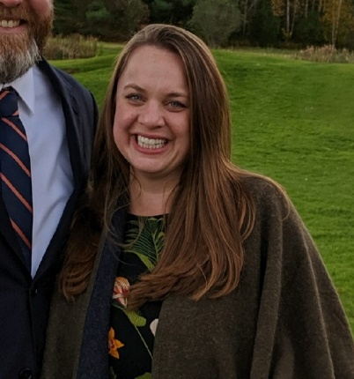
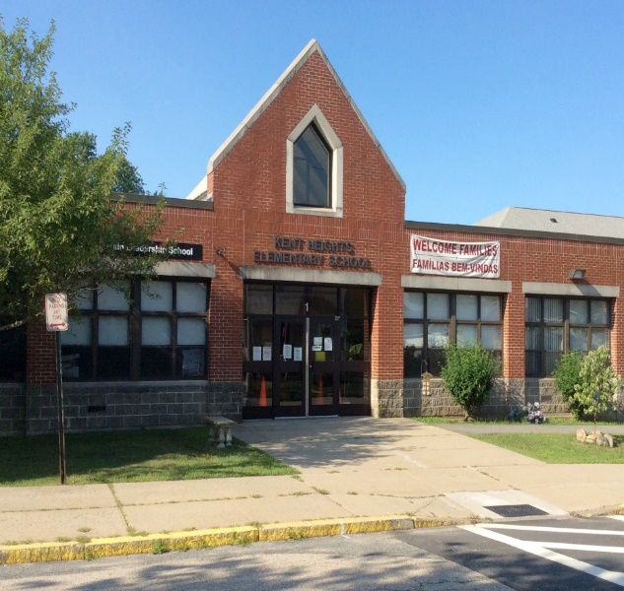
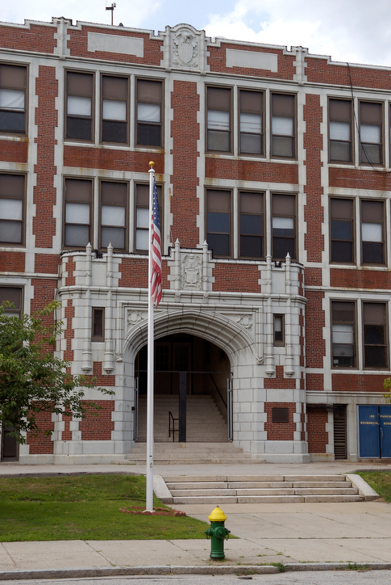
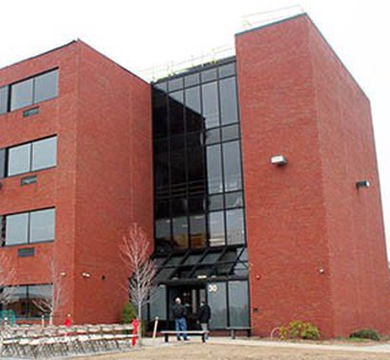
Thank you for your continued work!
School Nurses
Alexandra Doty, BSN, RN-BC
Myron J Francis Elementary School
Partnered with Pediatric Associates
Tracey Bradley, RN
Kent Heights School
Partnered with Barrington Pediatrics
Bethany Goldberg
Cumberland Elementary School
Partnered with Blackstone Valley Pediatrics
Colleen O’Donnell, BSN, RN
George J West Elementary
Partnered with Sunshine Pediatrics
Jennifer Castano
RISE Prep Mayoral Academy
School nurse – consultant to Asthma QI project
5/12/2022
Prepared by Care Transformation Collaborative of RI
‹#›

Slide 35
THANK YOU
Debra Hurwitz, MBA, BSN, RN
dhurwitz@ctc-ri.org
www.ctc-ri.org
CTC-RI
5/12/2022
Prepared by Care Transformation Collaborative of RI
‹#›

