Slide 1
Final Think Tank Meeting: Addressing Alcohol Use Disorder Among Patients in Primary Care
1/28/25

Slide 2
Meeting Objectives
Welcome
Review lessons learned from AUD think tank convening sessions
Identify themes across AUD think tank that align with innovative/best practices for AUD
Discuss potential strategies for AUD implementation among patients in primary care
Prepared by Care Transformation Collaborative of RI

Slide 3
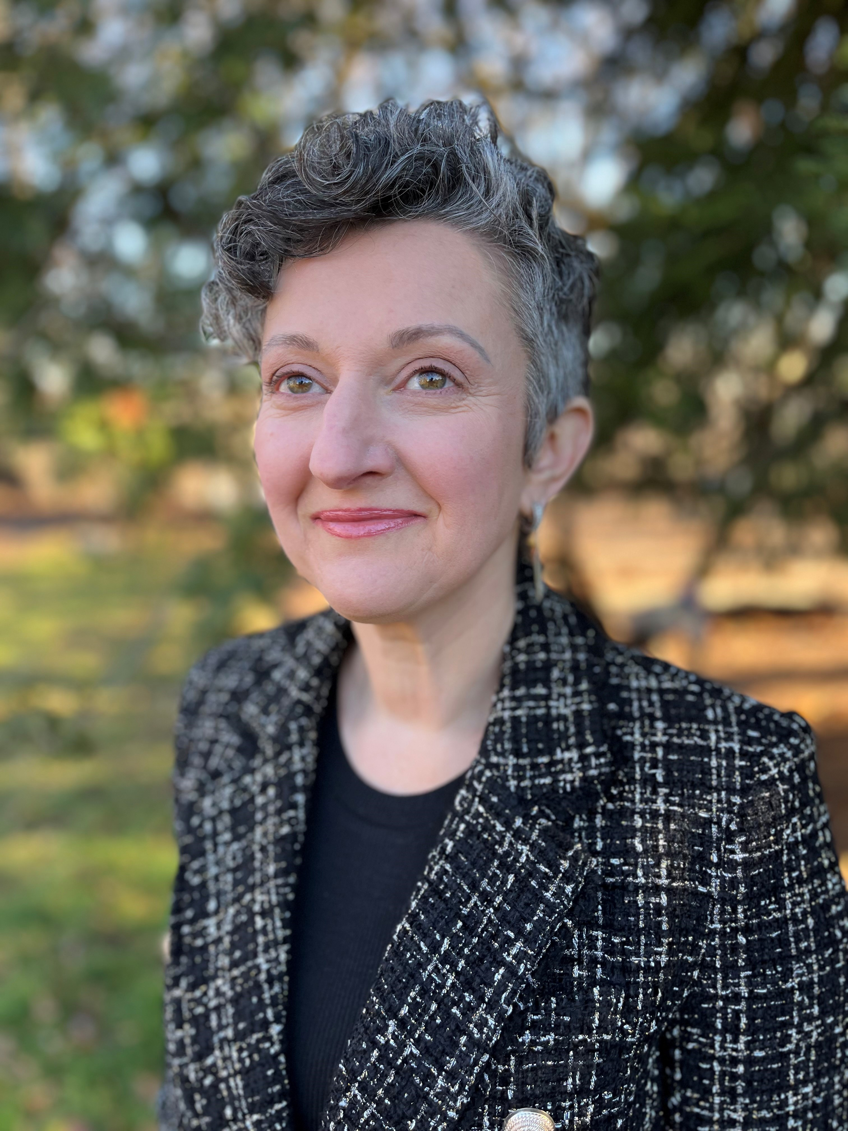
Transition News
Welcome Nelly Burdette, PsyD!
Chief Clinical Officer

Slide 4
Review of Think Tank Events
Think Tank Kick off “Improving Primary Care Capacity to Identify and Address Alcohol Use Disorders” in September 2024
CTC-RI Board supported the convening of a 5-part meeting series to generate themes connected to better addressing AUD in primary care, reviewing best practices and brainstorming potential strategies for implementation of AUD pilot
September 2024
October 2024
November 2024
Clinical Strategy Committee Meeting
December 2024
January 2025
Subject Matter Expert Session #3
Final Presentation -Recommendations
Subject Matter Expert Session #1*
Subject Matter Expert Session #2
*link to slides only, no recording available, additional notes upon request
Prepared by Care Transformation Collaborative of RI
Notes:
Linda

Slide 5
Acknowledgements
Special thanks to all those who participated from the following organizations:
ACT Clinic, Anchor Recovery, BHDDH, Brown Health (inclusive of Lifespan), Blackstone Valley Community Health Center (BVCHC), City of Providence,
CODAC, CVMC ROAD, East Bay Community Action Program (EBCAP), OHHS, Open Doors Health, Rhode Island College, Rhode Island Health Center Association (RIHCA), SMHLC, Thundermist Health Center, WellOne Community Health Center, Woodriver Health Center
Acknowledgement to our core think tank members: Garry Bliss (Prospect), Barry Fabius (Unitedhealthcare), Victor Pinkes (Blue Cross Blue Shield), Paul Larson (Brown Health), Rachel Wightman (RIDOH)
Recognizing Nash Klinger, ScM, Brown University Warren Alpert Medical School, who assisted in the environmental landscape
Prepared by Care Transformation Collaborative of RI

Slide 6
Themes Identified
Scope of Issue in RI
· Demographics, Populations of Special Interest
2. ED and Inpatient Visits for AUD play significant role
· Total Cost of Care
· Continuum of where it is most appropriate to seek care
3. Peer Recovery Coaches and CCBHCs identified as key linkages
Prepared by Care Transformation Collaborative of RI

Slide 7
Themes of Scale
15th
In 2021, RI ranked 15th highest consumer of alcohol in the US, with residents drinking 2.87 gallons of alcohol per capita, higher than the US average of 2.51 gallons of alcohol per capita.⁽¹⁾
Prepared by Care Transformation Collaborative of RI
Notes:
1. Slater, M. E., & Alpert, H. R. (2023). (rep.). Surveillance Reports: #120 Apparent Per Capita Alcohol Consumption: National, State, and Regional Trends, 1977-2021. National Institute on Alcohol Abuse and Alcoholism. https://www.niaaa.nih.gov/publications/surveillance-reports/surveillance120.

Slide 8
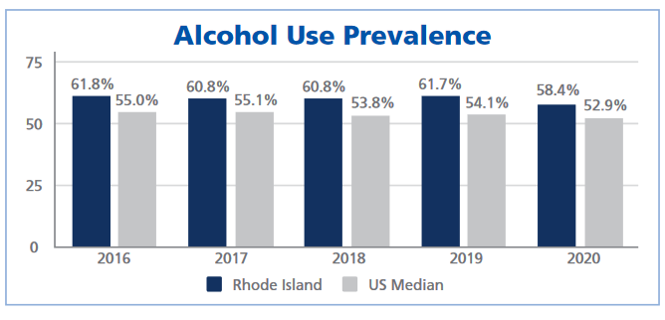
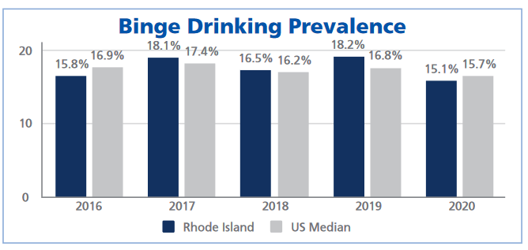
Alcohol Use in RI – Last 30 days
Rhode Island adults consistently reported drinking any alcohol in the past 30 days more often the median US adult, ranging from 5.5% to 7% higher, depending on the year.⁽²⁾
The percentage of Rhode Island adults who binge drink changed by year, with some years being higher than the US median and other years being lower.⁽³⁾
Prepared by Care Transformation Collaborative of RI
Notes:
2. Ledingham, E. & Scagos, R. (2022) Alcohol Use Prevalence [Table]. Rhode Island Department of Health. https://health.ri.gov/publications/reports/2016-2020AlcoholUse.pdf
3. Ledingham, E. & Scagos, R. (2022) Binge Drinking Prevalence [Table]. Rhode Island Department of Health. https://health.ri.gov/publications/reports/2016-2020AlcoholUse.pdf

Slide 9
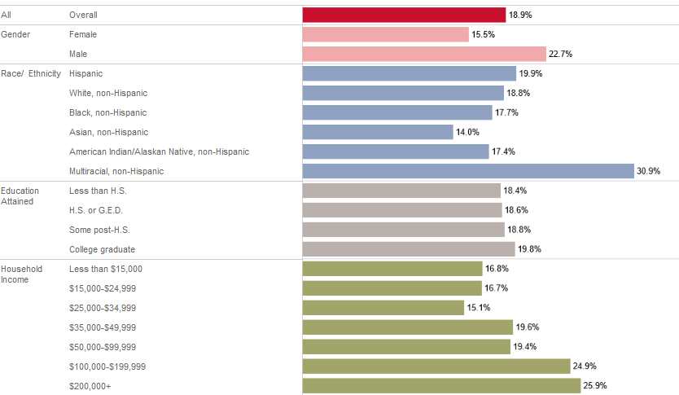
Rhode Island
Excessive
Drinking
Last 30 days (2022)⁽⁴⁾
by Demographics
Prepared by Care Transformation Collaborative of RI
Notes:
4. Health in Rhode Island. (2022). Excessive drinking demographic breakout [Table]. https://healthinri.com/data/excessive-drinking

Slide 10
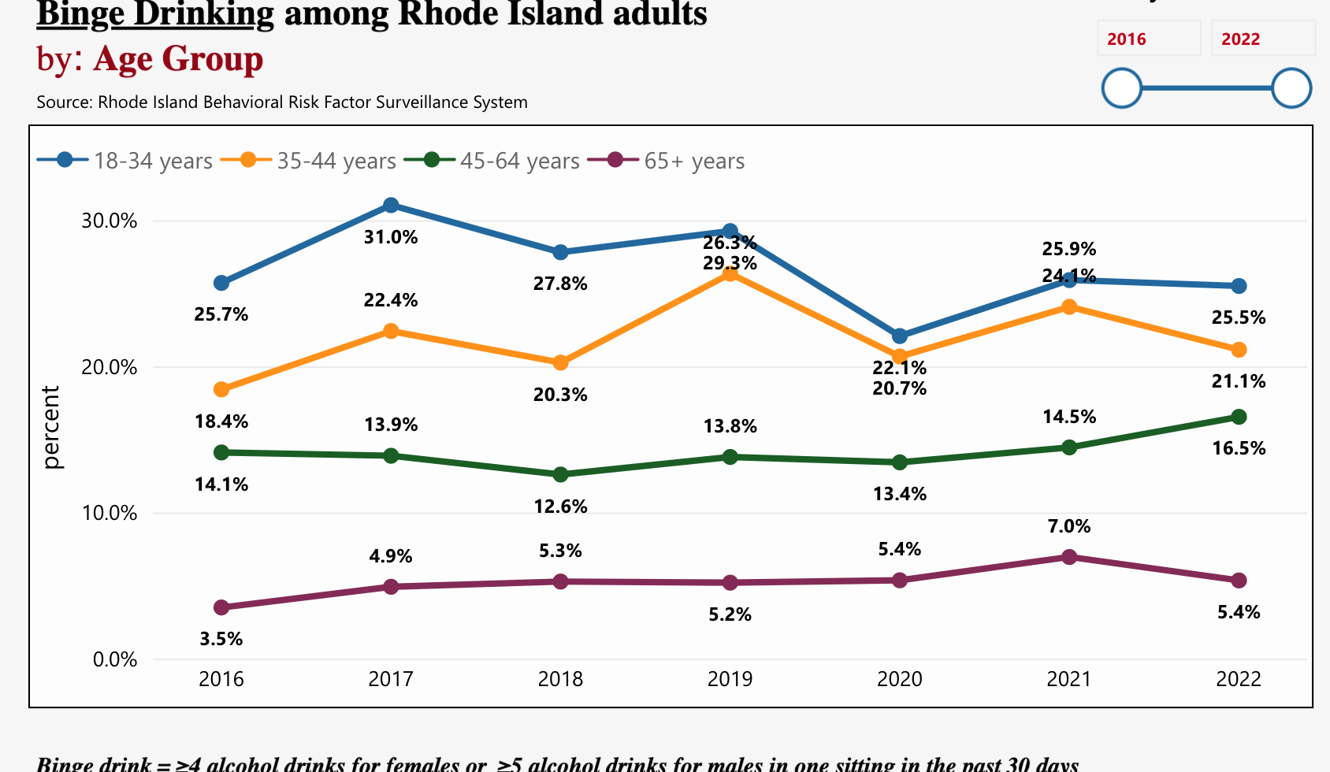
Rhode Island Binge Drinking by age group (2016-2022)⁽⁶⁾
Highest rates for 18–34-year-olds
Increase in binge drinking rates for adults age 35+ since 2016⁽⁵⁾
Rates of binge drinking in older adults (age 65+) doubled from 3.5% to 7% from 2016 to 2021⁽⁷⁾
Prepared by Care Transformation Collaborative of RI
Notes:
6. Rhode Island Behavioral Risk Factor Surveillance System. (2016-2022). Binge Drinking among Rhode Island adults by: Age Group [Interactive Table]. https://app.powerbigov.us/view?r=eyJrIjoiZmMyMWVkOWYtMDM0ZC00MTdiLWE3MTEtYzU4YWQ5YWM5MWFhIiwidCI6IjUyY2E2YTU0LTQ0NjUtNDYzNS1iZmYzLTY1ZDBhODQxMjI4OCJ9
7. Rhode Island Department of Health. (2023). Excessive Alcohol Use: Data Report 2023. https://ridoh-excessive-alcohol-surveillance-landing-page-rihealth.hub.arcgis.com/documents/be2cca0f05544f3992ef066abf67740e/about

Slide 11
Themes related to Scope from Thinktank
Important Sub-Populations (*inclusive of broader gender and sexual identity identifiers)
Prenatal/pregnant
Adolescent/Young Adult Focus
Older Population (Over 65 years old)
Homelessness/Unhoused
Males with statistically higher proportion of ED visits in State
Additional factors to consider
How to consider health equity and social determinants of health such as homelessness, access to internet (for apps or care linkages), primary language spoken, etc.
Balancing heath equity with the data that suggests higher education and household income more prevalent in RI for excessive drinking
Prepared by Care Transformation Collaborative of RI

Slide 12
Best Practices Discussed
Focusing on each Setting may yield different outcomes
ED vs Inpatient vs Community vs Primary Care
Engagement of Clinicians and Non-Clinical Staff
Peer Recovery Coaches
Community Organizations (CCBHCs or Specialty SUD)
Specialists in AUD care
ED Physicians
Prepared by Care Transformation Collaborative of RI

Slide 13
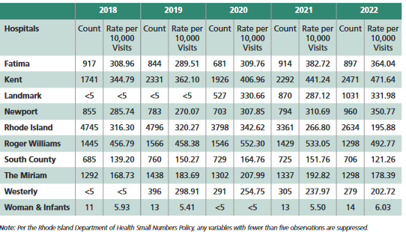
ED Visits in RI
Acute Alcohol Related ED Visits by Hospital⁽⁸⁾
In 2022, Rhode Island Hospital had the most ED visits for alcohol-related visits in the state (2,634 visits)
Roger Williams Hospital has the highest proportion of alcohol-related visits out of included hospitals in the state (492.77 per 10,000 visits)⁽⁹⁾
Prepared by Care Transformation Collaborative of RI
Notes:
8. Rhode Island Department of Health. (2023). Acute Alcohol-Related Emergency Department Visits by Hospital Patient Count and Rate per 10,000 visits in Rhode Island, National Syndromic Surveillance System [Table]. https://ridoh-excessive-alcohol-surveillance-landing-page-rihealth.hub.arcgis.com/documents/be2cca0f05544f3992ef066abf67740e/about
9. Rhode Island Department of Health. (2022). Rhode Island Data Brief: Alcohol-Related Emergency Department Visits in Rhode Island, 2018-2021. https://health.ri.gov/publications/reports/2018-20201Alcohol-ED-Visits.pdf14

Slide 14
Behavioral Health Ecosystem
AUD Pilot to
focus here
Graphic originally from:

Slide 15
Poll: Potential pilot areas of focus (1/3)
Content areas
Engage CCBHC connection to Primary Care through Designated Community Organizations or DCOs (i.e., primary care practices) and establish best practices to meet quality measures
Identify how peer recovery coaches in ED (pre/post ED discharge) could be better leveraged in coordination with primary care across the State including interdisciplinary huddles
Focus on whether addressing isolation only vs isolation + AUD intervention vs control group could be an indirect pathway
From a population health perspective, focus on rising risk in primary care vs highest risk? (multiple ED visits across discrete time-period)
Anything else?
Training Options
PCPs and ED Providers (BMC’s Training Center – Grayken with a focus on harm reduction and trauma-informed care)
Consider revamping treatment protocols to guide ED decision making
Other options?

Slide 16
Poll: Potential pilot areas of focus (2/3)
Population Categories (*inclusive of broader gender and sexual identity identifiers)
Adolescents during High School/College age range
18+, ED/Inpatient AUD events (include perinatal/post-partum?)
65+ population and Isolation (Examples: Nursing Home Collaboration - Brightview Place/State Assisted Living or Meals on Wheels customers)
Homeless population (Example: Matthewson St Church)
Any exclusion populations within initial pilot due to approach/framework being substantially different?
Anything else?
Method of delivery Options
Learning Collaborative including practice facilitation
Practice Facilitation only
Training (ECHO model, etc)
Other options?

Slide 17
Poll: Potential pilot areas of focus (3/3)
Policy
Annual Wellness Visit with Screening for all substances but alcohol at minimum to occur in primary care (building on Massachusetts approach)
Regulatory changes on minimum blood alcohol content levels before referring to Behavioral Health/SUD Provider
Any other policy change would be helpful to change?
Community
Church involvement: Imani program developed at Yale
Peace Love: arts activities that are recovery oriented for social prescribing that is local
Any other community organizations to include?
Prepared by Care Transformation Collaborative of RI

Slide 18
Open Discussion
Is there anyone or any topic we haven’t heard from yet or know enough about?
Prepared by Care Transformation Collaborative of RI

Slide 19
Next Steps
Present to Clinical Strategy Clinical Committee on 2/21 with final recommendations
Obtain funding needed to pilot the final recommendation(s) identified as next best steps:
Identify funding partners from:
Rhode Island Foundation Community Priority Grants: https://assets.rifoundation.org/documents/2025-Grant-App.-Award-Timelines-2.pdf
Research & Evaluation (given the limited evidence-based research in literature) –Advance RI-CTR
Build upon the previous work of AHRQ Implementation in 2019 of EvidenceNOW:
Scope: Funded in 6 states and implemented in primary care representing rural, suburban, and urban practice serving diverse communities ⁽¹¹⁾.
Goal: Raise awareness for evidence-based screening, augment rates of screening for AUD, increase rates of brief intervention and referral treatment, increase use of medication-assisted treatments ⁽¹¹⁾.
Results: Evidence-based screening and counseling for unhealthy alcohol use can be successfully implemented with electronic health record tools; our initial quality improvement project, which benefited from dedicated funding and a multi-disciplinary team, resulted in screening and counseling rates greater than those reported in national data ⁽¹¹⁾.
Prepared by Care Transformation Collaborative of RI

Slide 20
Questions and Thank You!
Once funded, would you like to be part of the Multistakeholder Advisory Oversight Committee? If so, please indicate so in the chat
If you would like to provide written commentary or have questions via email prior to 2/21/25, please reach out to Nelly Burdette, Chief Clinical Officer: nburdette@ctc-ri.org
Prepared by Care Transformation Collaborative of RI

Slide 21
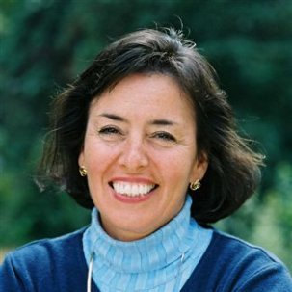
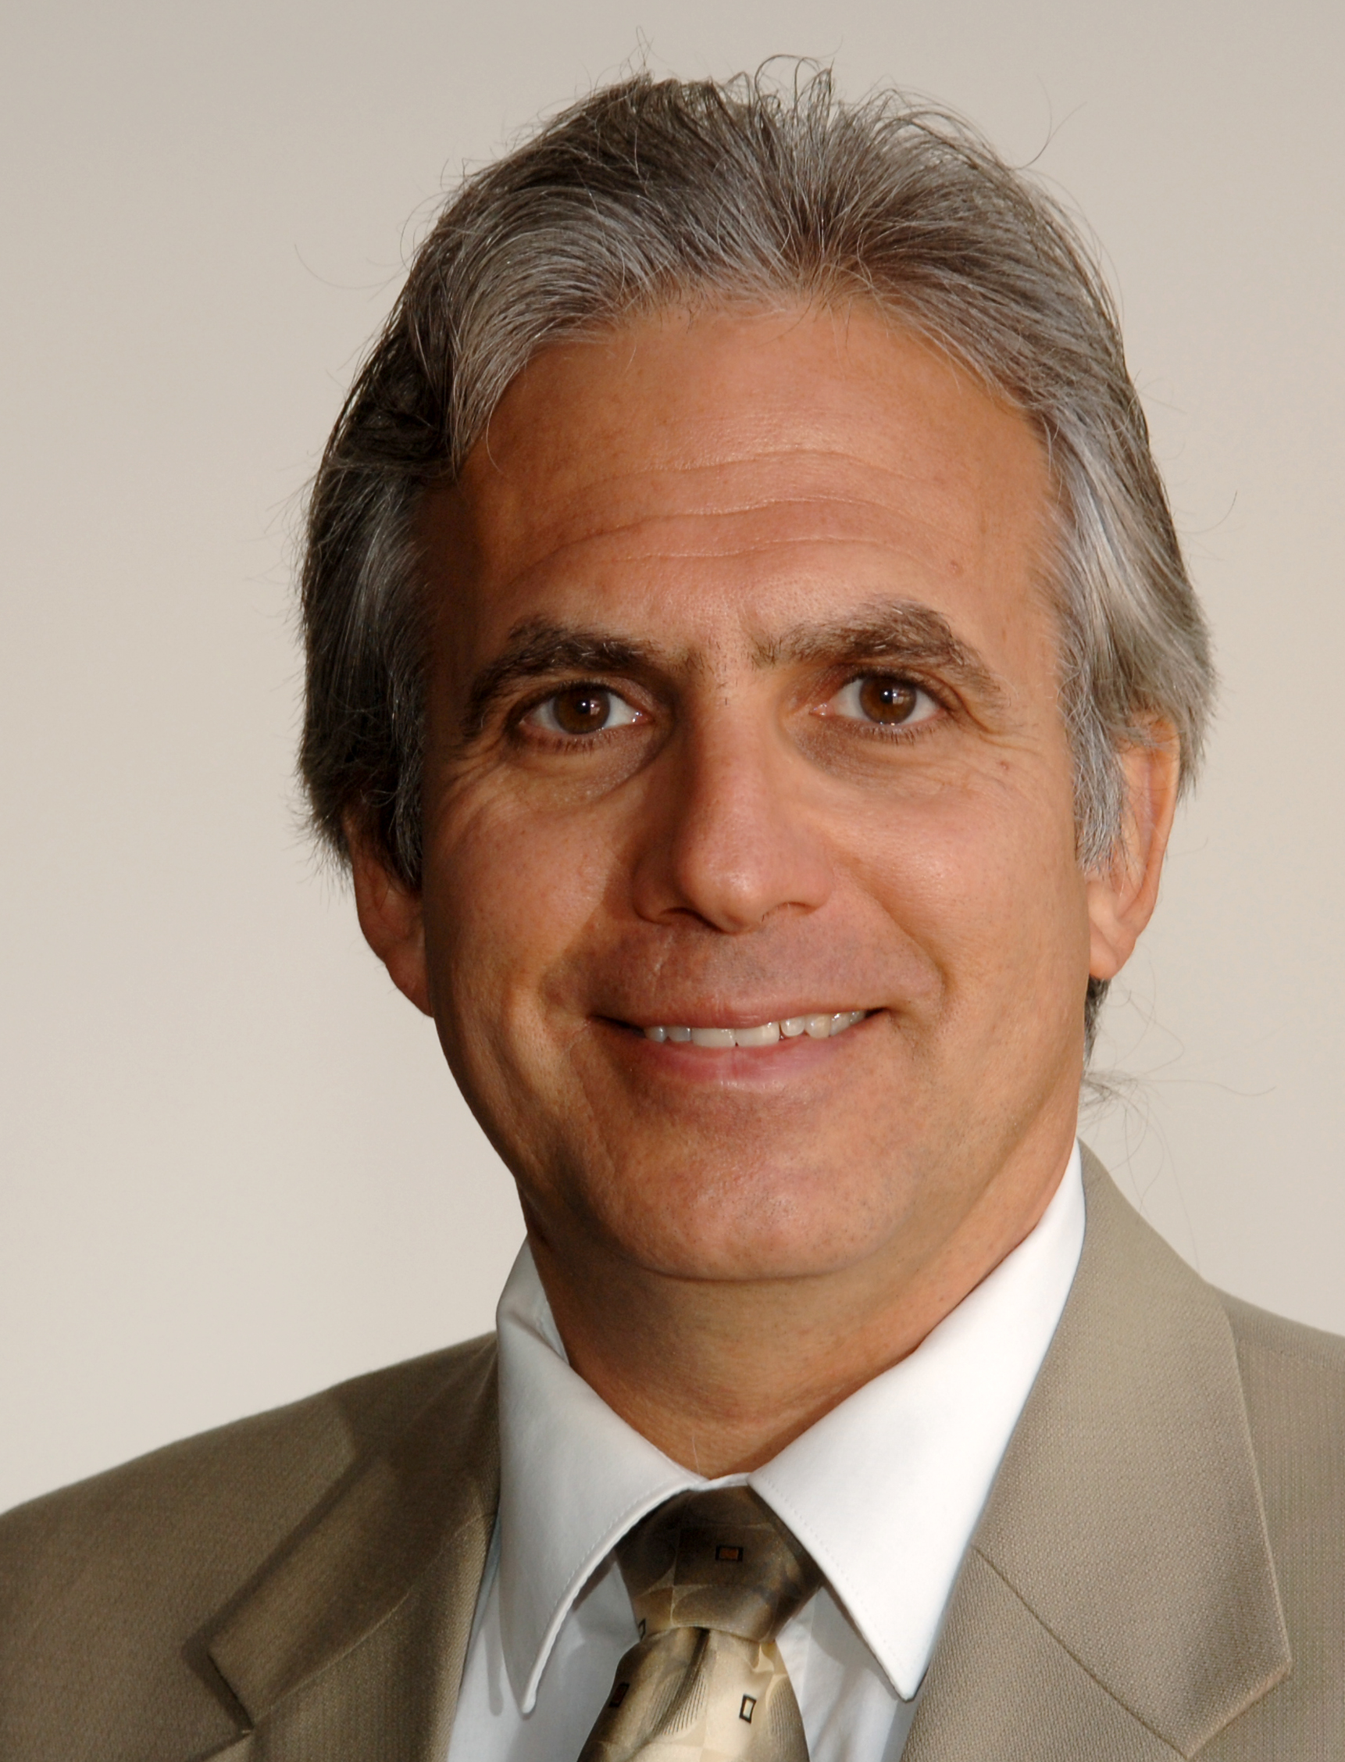
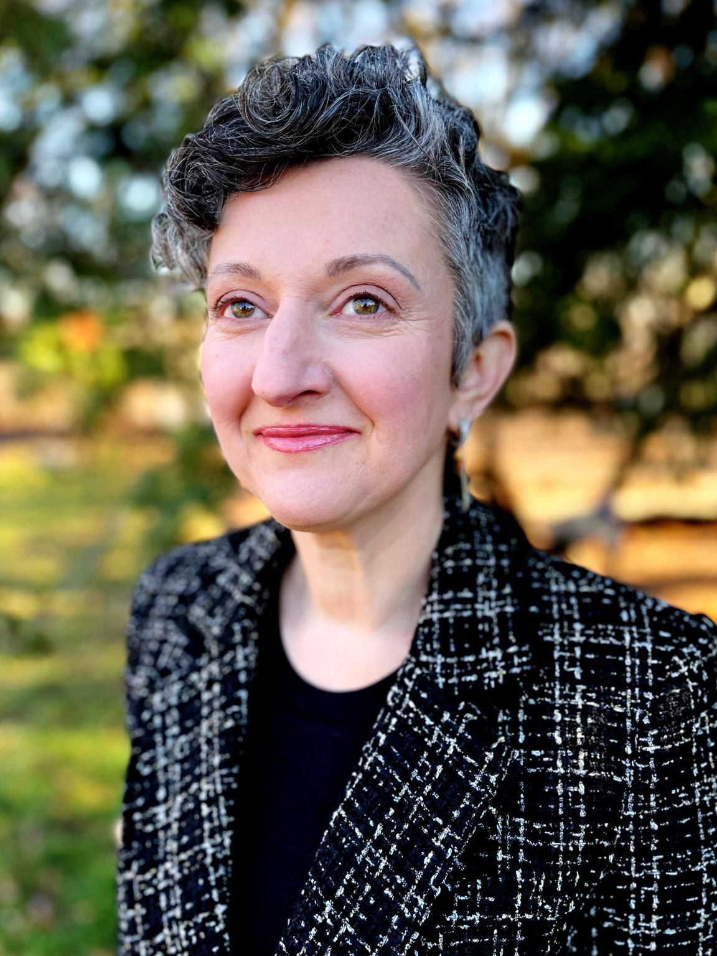
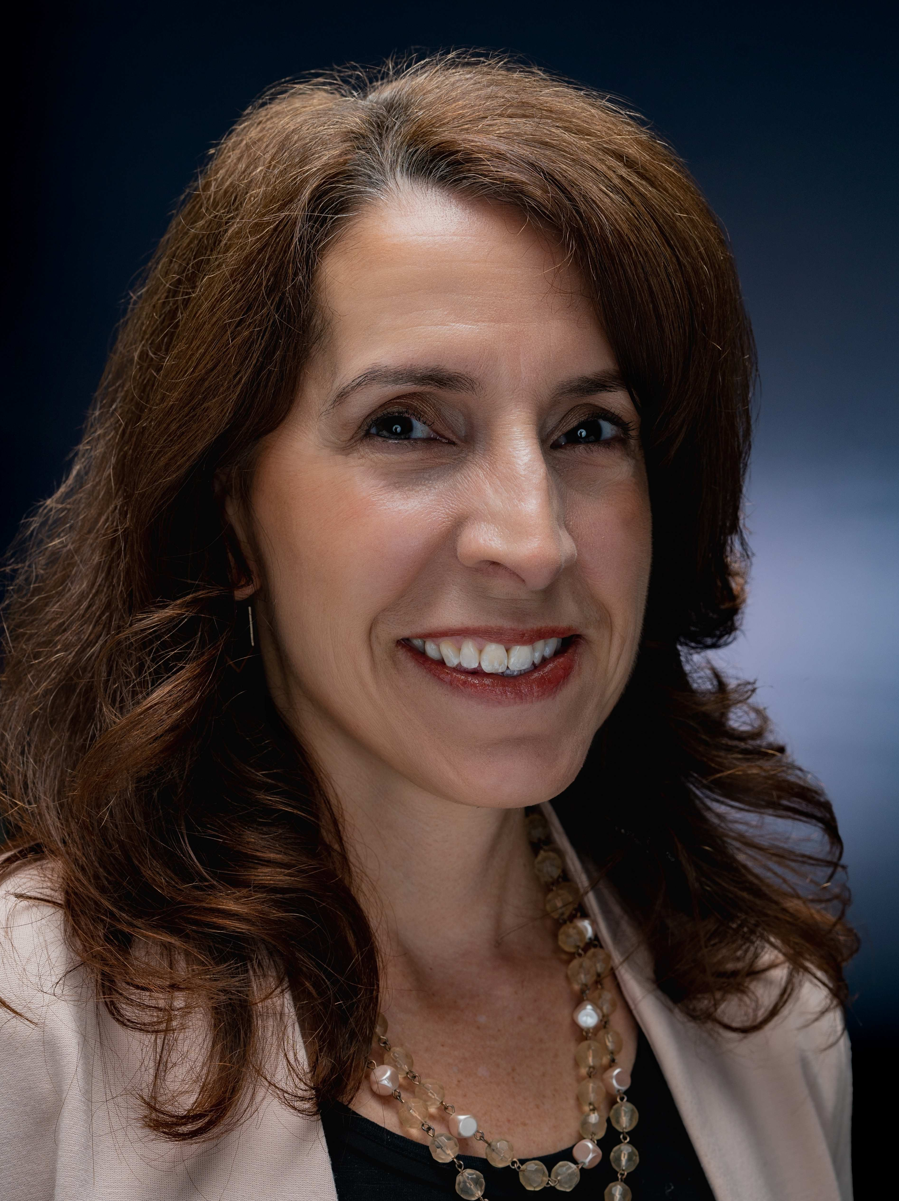
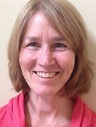
CTC-RI Senior Leadership Thanks You
Deb Hurwitz, MBA, BSN, RN, Executive Director
Pano Yeracaris, MD, MPH, Chief Clinical Strategist
Patricia Flanagan, MD Clinical Director & PCMH Kids Co-Chair
Nelly Burdette, PsyD
Chief Clinical Officer
Linda Cabral, MM, Senior Program Manager
Yolanda Bowes, BS
Senior Project Manager
Susanne Campbell, RN, MS, PCMH CCE, Senior Program Administrator
Prepared by Care Transformation Collaborative of RI
Notes:
All – Pat last then Introduces the Practices

Slide 22
References
Slater, M. E., & Alpert, H. R. (2023). (rep.). Surveillance Reports: #120 Apparent Per Capita Alcohol Consumption: National, State, and Regional Trends, 1977-2021. National Institute on Alcohol Abuse and Alcoholism. https://www.niaaa.nih.gov/publications/surveillance-reports/surveillance120.
Ledingham, E. & Scagos, R. (2022) Alcohol Use Prevalence [Table]. Rhode Island Department of Health. https://health.ri.gov/publications/reports/2016-2020AlcoholUse.pdf
Ledingham, E. & Scagos, R. (2022) Binge Drinking Prevalence [Table]. Rhode Island Department of Health. https://health.ri.gov/publications/reports/2016-2020AlcoholUse.pdf
Health in Rhode Island. (2022). Excessive drinking demographic breakout [Table]. https://healthinri.com/data/excessive-drinking
Rhode Island Behavioral Risk Factor Surveillance System. (2016-2022). Binge Drinking among Rhode Island adults by: Age Group [Interactive Table]. https://app.powerbigov.us/view?r=eyJrIjoiZmMyMWVkOWYtMDM0ZC00MTdiLWE3MTEtYzU4YWQ5YWM5MWFhIiwidCI6IjUyY2E2YTU0LTQ0NjUtNDYzNS1iZmYzLTY1ZDBh ODQxMjI4OCJ9
Rhode Island Behavioral Risk Factor Surveillance System. (2016-2022). Binge Drinking among Rhode Island adults by: Age Group [Interactive Table]. https://app.powerbigov.us/view?r=eyJrIjoiZmMyMWVkOWYtMDM0ZC00MTdiLWE3MTEtYzU4YWQ5YWM5MWFhIiwidCI6IjUyY2E2YTU0LTQ0NjUtNDYzNS1iZmYzLTY1ZDBh ODQxMjI4OCJ9
Rhode Island Department of Health. (2023). Excessive Alcohol Use: Data Report 2023. https://ridoh-excessive-alcohol-surveillance-landing-page- rihealth.hub.arcgis.com/documents/be2cca0f05544f3992ef066abf67740e/about
Rhode Island Department of Health. (2022). Rhode Island Data Brief: Alcohol-Related Emergency Department Visits in Rhode Island, 2018-2021https://health.ri.gov/publications/reports/2018-20201Alcohol- ED-Visits.pdf14.
Rhode Island Department of Health. (2023). Acute Alcohol-Related Emergency Department Visits by Hospital Patient Count and Rate per 10,000 visits in Rhode Island, National Syndromic Surveillance System [Table]. https://ridoh-excessive-alcohol-surveillance-landing-page-rihealth.hub.arcgis.com/documents/be2cca0f05544f3992ef066abf67740e/about
Rhode Island Department of Health. (2022). Rhode Island Data Brief: Alcohol-Related Emergency Department Visits in Rhode Island, 2018-2021. https://health.ri.gov/publications/reports/2018-20201Alcohol- ED-Visits.pdf1
Stanojlović, M., & Davidson, L. (2021). Targeting the Barriers in the Substance Use Disorder Continuum of Care With Peer Recovery Support. Substance Abuse : Research and Treatment, 15, 1178221820976988. https://doi.org/10.1177/1178221820976988
EvidenceNOW: Managing Unhealthy Alcohol Use. (n.d.). Www.ahrq.gov. https://www.ahrq.gov/evidencenow/projects/alcohol/index.html
Prepared by Care Transformation Collaborative of RI

