Slide 1
Breakfast of Champions:
Gender Affirming Care
Breakfast of Champions | December 8, 2023

Slide 2
Agenda
Presenter/Topic | Time
Welcome Pat Flanagan, MD, Clinical Director and PCMH Kids Co-Chair | 5 minutes
Demographic Data Collection Pilot Opportunity Feedback Yolanda Bowes | 10 minutes
Dispelling the Myths and Misinformation: What is Gender Affirmative Care Jason Rafferty, MD, MPH, EdM, Pediatrician and Child Psychiatrist, Lifespan | 25 minutes
Discrimination & the Impact on Accessing Gender Affirming & Queer Competent Mental Health Amy Nunn, ScD, MS, Executive Director Rhode Island Public Health Institute Professor of Public Health and Medicine, Brown University | 25 minutes
Q&A / Discussion | 15 minutes

Slide 3
Announcements
Team Based Care: Safe Sleep – register here
Please join us for our December 19th Team-Based Care Meeting, focusing on Safe Sleep. Margo Katz, MA, Program Manager for Safe Sleep and Substance Exposed Newborns at the Rhode Island Department of Health will provide an overview of Sudden Unexpected Infant Death (SUID), including common causes and state data, and evidence-based recommendations for safe sleep.
The second half of the presentation will focus on delivering safe sleep messaging to families. Parent Kiana Cruz will share her experience with safe sleep, and we will be joined by Maria Camarena, Parents as Teachers program supervisor at Westerly Public Schools, and Wendy Lincoln, Clinical Supervisor for the Healthy Families America program at CCAP. Maria and Wendy will share their experiences as family home visitors and give recommendations for having difficult, culturally competent conversations with families about safe sleep.

Slide 4


CTC-RI Conflict of Interest Statement
If CME credits are offered, all relevant financial relationships of those on the session planning committee have been disclosed and, if necessary, mitigated.
Claim CME credits here: https://www.surveymonkey.com/r/ZDZS5HG
The AAFP has reviewed ‘Advancing Comprehensive Primary Care Through Improving Care Delivery Design and Community Health,’ and deemed it acceptable for AAFP credit. Term of approval is from 03/18/2022 to 03/18/2023. Physicians should claim only the credit commensurate with the extent of their participation in the activity. NPs and RNs can also receive credit through AAFP’s partnership with the American Nurses Credentialing Center (ANCC) and the American Academy of Nurse Practitioners Certification Board (AANPCB).

Slide 5
Objectives
Discuss staff and patient feedback concerning gender and sexuality data collection
Learn about and discuss the important role that primary care can play in delivering gender affirming care
Learn about the effects of discrimination on mental health in gender affirming care

Slide 6

Demographic Data Collection Pilot Opportunity
Breakfast of Champions 12 8 23
5/12/2022
Care Transformation Collaborative of Rhode Island
‹#›
Prepared by Care Transformation Collaborative of RI

Slide 7
Demographic Data Collection Pilot
Project Overview
Funded by CDC/Rhode Island Department of Health/Rhode Island Executive Office of Health & Human Services.
15 Primary Care Practices – Adult, Peds, Family Practice
Project Timeline – May 2023 – May 2024 – Educational Focus
Environmental Scan Reports – Best Practice, RI Demographic Data Collection Performance, Current & Anticipated Standards
Baseline Needs Assessment (8/15 – 9/15) – Practice Assessment (15), Patient Survey (1190), Staff Survey (89 ), Walk Around Tool (15) 6 Session
6 Session Webinar Series

Slide 8
Baseline Practice Needs Assessment Report
Patient Survey – 1190 Responses – 943 answered 243 Skipped
Comfortable or Very Comfortable Providing SOGI to Practice Staff
Sex Assigned at Birth – 85% Race – 80%
Gender Identity – 82% Ethnicity – 80%
Pronouns – 77% Language – 85%
Sexual Orientation – 79%
Comfortable or Very Comfortable Providing SOGI to Provider
Sex Assigned at Birth – 86% Race – 85%
Gender Identity – 84% Ethnicity – 84%
Pronouns – 81% Language – 87%
Sexual Orientation – 82%
Notes:
80% feel it’s important for their provider to know this information
67% feel this information can help healthcare providers understand and address health inequitites

Slide 9
Baseline Practice Needs Assessment Report
Staff Survey 89 Responses - 77 Responses 12 Skipped
Comfortable or Very Comfortable Collecting SOGI from Patients
Sex Assigned at Birth – 38% Race – 49%
Gender Identity – 30% Ethnicity – 53%
Pronouns – 30% Language – 70%
Sexual Orientation – 30%

Slide 10
Baseline Practice Needs Assessment Report
38% of Staff Report Challenges (30 responses)
Staff Comments
“Some elderly find the questions insulting”
“[Patients]Refuse to complete gender identity. Refusal of providing any information regarding sexual orientation, gender, identity, pronouns. Some only want to discuss in private.”
“It is uncomfortable to ask in front of everyone.”
“Private, sensitive information that they may not want to share with the receptionist in lobby”.
“Don’t collect. Don’t see it as necessary”.

Slide 11
Baseline Practice Needs Assessment Report - Patient Comments
“I hope this makes sense. I am a straight, white, old-school guy. I look like the part so nobody expects me to be otherwise. When asked identify questions either verbally or in person, the doctor’s office staff expect me to be what I appear to be. So…if I looked like do but was gay or trans or whatever, I might be uncomfortable with the idea that the doctor or staff assume I am straight and treat that as routine. I might be hesitant to tell the truth about my identity. The fact that everyone in the office appears to assume I am what I look like, might make me uncomfortable”.
“Make it optional and don’t need yearly. I am a 60-year-old, and I won’t be changing my gender and all the other stuff that has been the same for 60 years. Collect if relevant.”
“Sometimes the staff seem uncomfortable asking the personal questions which I can imagine for some people it could cause them not to reveal the truth because they get the sense that the asker either doesn’t really care or just doesn’t know how to handle what could be said. Which isn’t their fault they are not trained mental health workers so they can imagine they get all kinds of pieces if info that they don’t know what to do with.”
5/12/2022
Prepared by Care Transformation Collaborative of RI
‹#›

Slide 12
Patient Comments Continued - Pediatrics
“I think it is terrible that 14-year-olds can call the shots on their health and parents can’t be involved. I think it is disgusting”.
“As a parent of a young child with 2 white cisgender, straight parents, these conversations are easy for us but that should not in any way discount how different these conversations can be for others. I personally feel these are important discussions to have with doctors.”
“Let these be kids and not pressure them with all this identify crisis that is going on in the world.”
“Asking about pronouns and preferred sex and sex assigned at birth for all patient is unnecessary and should not be required especially in pediatric setting as it is confusing and does not reflect the majority population and is a mental health issue.”
5/12/2022
Prepared by Care Transformation Collaborative of RI
‹#›

Slide 13
BASELINE PRACTICE NEEDS ASSESSMENT SUMMARY REPORT
KEY FINDINGS – Identified Needs Across Surveys
Best practice for asking patients for race, ethnicity and language information and responding to their questions/reaction
Best practice for asking patients about sexual orientation and gender identity.
Working with IT and vendors to improve data capture and reporting
Methods and Tools such as scripts, role playing, frequently asked questions documents, front desk standard sample (Training staff)
Best practices in workflow to improve the completeness and accuracy of data collection
Using data to understand and address disparities in the healthcare delivery and outcomes
Using technology to collect demographic data (patient portal, kiosk, tablet)
Collaborating with local community groups to engage and understand specific sub-populations served by your practice
Cultural competency, systemic racism, implicit bias, and implications for health equity (Patient Needs)
Changing federal and state data standards for collection of race and ethnicity data
Establishing a process such as a patient advisory committee to improve health equity in your practice
5/12/2022
Prepared by Care Transformation Collaborative of RI
‹#›

Slide 14
Dispelling the Myths and Misinformation: What is Gender Affirmative Care
Jason Rafferty, MD, MPH, EdM
Gender & Sexuality Program Medical Director
Hasbro Children’s Hospital
Clinical Assistant Professor
Warren Alpert Medical School of Brown University

Slide 15
Disclosure Information
I have no relevant financial relationships with the manufacturer(s) of any commercial product(s) and/or provider(s) of commercial services discussed in this CME activity.
I do intend to discuss an unapproved/investigative use of a commercial product/device in my presentation.
Gender Identity Disclosure

Slide 16
Objectives
Recognize the essential aspects of the gender affirmative care model and how it applies to youth and their families
Appreciate how cumulative trauma and stigma contributes to mental health disparities and ways providers can foster resiliency
Discuss the importance of family support and ways providers can foster parental understanding and acceptance

Slide 17
Understanding Gender

Slide 18



Slide 19

The “Binary”

Slide 20
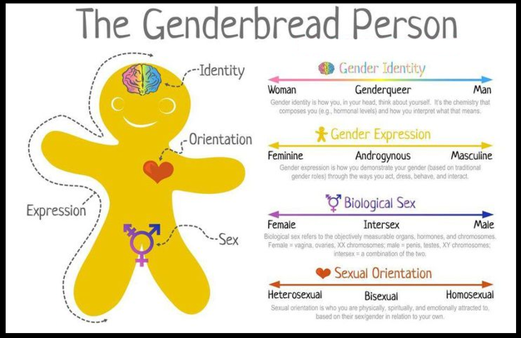
http://itspronouncedmetrosexual.com/2015/03/the-genderbread-person-v3/

Slide 21
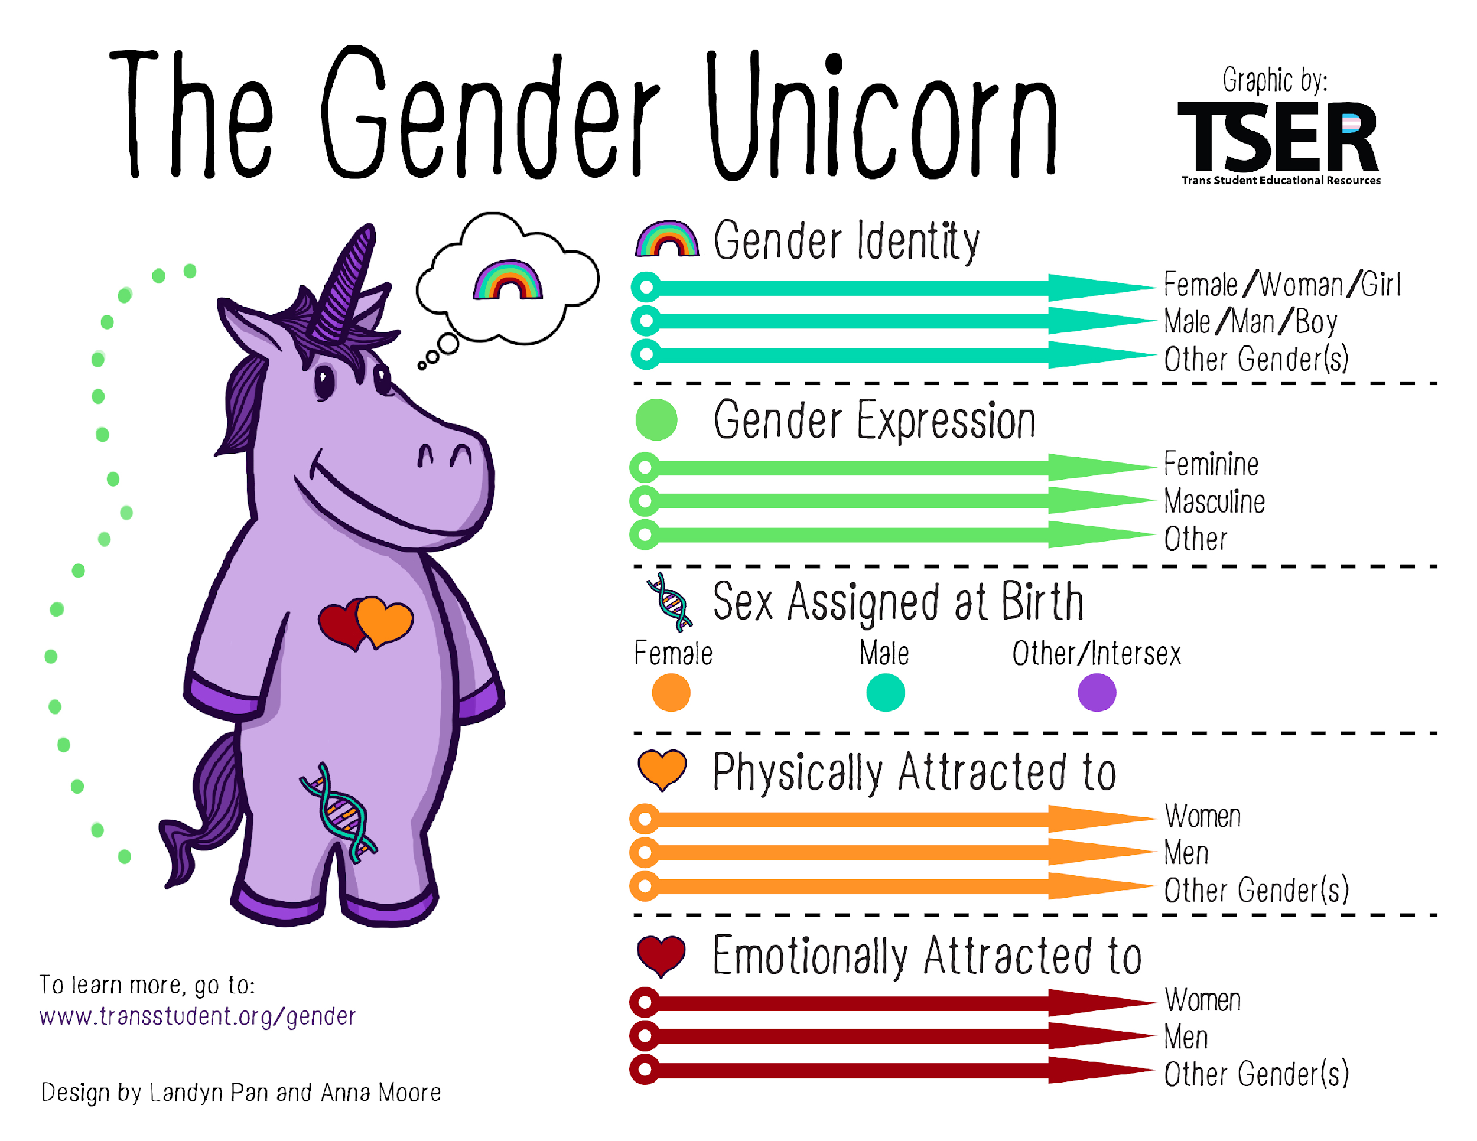
http://itspronouncedmetrosexual.com/2015/03/the-genderbread-person-v3/

Slide 22

Images taken from The Gender Book, are publicly available on the book’s website, www.thegenderbook.com
Notes:
Assumption 1: Gender is dynamic

Slide 23
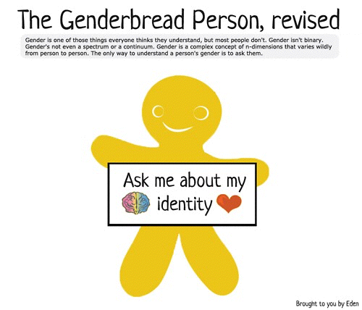
Notes:
How should you refer to a person who is gender diverse?
It depends on the labels the want to use. Labels are confusing and continually evolving. The best approach is to ask people directly and nonjudgmentally what name, pronouns, and if there are any labels they prefer. This provides an opportunity for the person to also discuss their experience and feelings before making any assumptions.
In general, transgender and gender diverse are umbrella terms to describe an ever-evolving array of labels people may apply when their gender identity, expression, or even perception does not conform to the norms and stereotypes others expect.

Slide 24
Mental Health

Slide 25

  The Most Vulnerable
  Population
41% Lifetime suicide attempts in adults
57% diagnosed with depression
40% diagnosed with anxiety
53% self –harmed
63% victim of sexual assault
61% victim of physical assault
High rates of poverty, sex work, HIV+, substance abuse, homelessness, employment and housing discrimination
Haas AP, Rodgers PL, Herman JL. Suicide Attempts Among Transgender and Gender Non-Conforming Adults: Findings of the National Transgender Discrimination Survey. American Foundation for Suicide Prevention and The Williams Institute; 2014
Notes:
Nothing inherent

Slide 26
“Going Underground”
Sociocultural Pressures Lead Children and Teens to Suppress rather than Explore Gender Diverse Identity
Fosters Internalization and Self Criticism
  Secretive Thoughts, Feelings, Behaviors
Negative Self-Concept Reinforced by:
  Parental Distress
  Criticism in Social Settings
  Bullying
Can Affect Mental Health
  Depression
  Anxiety
  High Risk Behaviors
  Suicidality, Self-Injury

Slide 27
Stigma
Lack of Family Support
Concealment of Identity
Bullying & Victimization
Internalized Transphobia
Discriminatory Laws and Policies
Rigid Gender Norms
Lack of Gender-Affirming Healthcare
Negative Peer Relationships
Micro-Aggressions
Acute and Cumulative Trauma

Slide 28
Gender or sexual minority
(any social minority status)
Meyer IH. Prejudice, social stress, and mental health in lesbian, gay, and bisexual populations: conceptual issues and research evidence. Psychol Bull. 2003 Sep;129(5):674-97.
Stigma
Prejudice, Discrimination, Abuse
Lack of Acceptance
Isolation, Esteem, Resources
Suicide
Substance use
SES disadvantage
Victimization
Physical M&M
Anxiety
Depression
CV Disease
Cortisol,
SNS,
Stress Resp
MINORITY STRESS
Notes:
28
J Psychiatr Pract. 2014 May;20(3):225-7. doi: 10.1097/01.pra.0000450322.06612.a1.
Mental health as an advocacy priority in the lesbian, gay, bisexual, and transgender communities. Pandya A.
Arch Sex Behav. 2014 Nov;43(8):1559-70. doi: 10.1007/s10508-014-0268-4. Epub 2014 Feb 27.
Explaining the suicide risk of sexual minority individuals by contrasting theminority stress model with suicide models. J Gay Lesbian Soc Serv. 2013;25(4). doi: 10.1080/10538720.2013.829395.
Minority Stress Theory: An Examination of Factors Surrounding Sexual Risk Behavior among Gay & Bisexual Men Who Use Club Drugs.
Dentato MP¹, Halkitis PN, Orwat J.
Plöderl M¹, Sellmeier M, Fartacek C, Pichler EM, Fartacek R, Kralovec K.
J Homosex. 2011;58(1):117-37. doi: 10.1080/00918369.2011.533631.
Stress-related growth, coming out, and internalized homonegativity in lesbian, gay, and bisexual youth. An examination of stress-related growth within the minority stress model. Cox N¹, Dewaele A, van Houtte M, Vincke J.

Slide 29
Gender & Mental Health
“Socially transitioned transgender children who are supported in their gender identity have developmental normative levels of depression and only minimal elevations in anxiety, suggesting that psychopathology is not inevitable within this group.”
(Olson et al, 2016)

Slide 30
Mental Health Needs
Focus Groups with TGD youth found that the top things they need/desire from adults:
Validation
Acceptance
Unconditional Support
(Note that it is no different from their heterosexual cis-gendered peers)
Family and community support are essential for children's healthy development.

Slide 31
Gender Diverse Children

Slide 32
Gender Diverse Children
2-10% of Children Under Age 12 Display Regular Gender Diverse Behaviors, Very Few Express Interest in Changing their Gender (Pediatrics, 2012, 129, 571-573)
Of 9,000 Kids, 83% of Those Reporting Gender Diverse Play in Childhood Later Identified as “Heterosexual, Cis-Gendered” as Adults (Pediatrics, 2012; 129; 410-417)
Preschool Children Tend to Use Gender Conforming Toys Less and Gender Diverse Toys More When They Believe They Are Alone
Frequency and Intensity of Fantasy Play Involving Cross-Gender Roles Appears to be the Same Among Preschool Boys and Girls.

Slide 33
Gender Diverse Children
Can young children really know if they are transgender?
Research suggests that children who assert a gender diverse identity know their gender as clearly and consistently as their developmentally matched peers and benefit from the same level of support, love, and social acceptance.
Gender development is a normal process for all children. Some children will exhibit variations in expression, similar to all areas of human health and behavior.

Slide 34
Chief Complaints
“She never wanted to wear dresses.”
“He liked to play with dolls and dress up with his sisters.”
“She always wanted to have her hair cut short.”
“He did not want to join little league like his brother did.”
“All her friends are boys.”
“S/he was always a little different from peers, even as early as in preschool or kindergarten.”
“He drove his father crazy by never wanting to join his brothers outside but instead playing with his sister and her friends.”
“She told me in first grade that she was a boy.”
“He wanted to grow his hair long and wear jewelry.”
“She adamantly refused to wear a dress to her aunt’s wedding.”
“He wanted to be in the school play in the role of Cinderella.”

Slide 35
Gender Diverse Children
Exploration of diverse gender roles is normal in young children as part of their social/emotional development
#1 Intervention: Reassurance, Safety, & Education
Research suggests that children who assert a gender diverse identity know their gender as clearly and consistently as their developmentally matched peers and benefit from the same level of support, love, and social acceptance.
        Do NOT try to suppress the child’s evolving identity or exploration (i.e. “It is a phase”), which is invalidating to the child & family, and can lead to guilt & shame.

Slide 36

Gender Diverse Children
CAUTION: “Watch & Wait”
It used to be the case that for children, gender-diverse assertions were held as “possibly true” and not acknowledged until an age when the child was believed to be old enough to know for sure or were “distressed enough” that it was clear.
This is does not serve the child, because it increases discomfort without offering critical support and understanding. Attempts at predicting or changing who a child may become have shown to be unsuccessful, and even harmful.

Slide 37
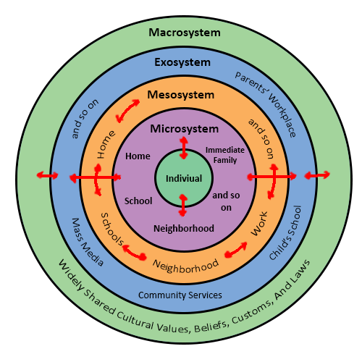

Slide 38
Gender Diverse Children
Developmentally Appropriate Assessment
Rafferty, J. R., Donaldson, A. A., & Forcier, M. (2020). Primary Care Considerations for Transgender and Gender-Diverse Youth. Pediatr Rev, 41(9), 437-454. doi:10.1542/pir.2018-0194
Leibowitz, S., & Janssen, A. (2018). Affirming and Gender-Informed Assessment of Gender Diverse and/or Transgender Youth Across Development. In A. Janssen & S. Leibowitz (Eds.), Affirmative Mental Health Care for Transgender and Gender Diverse Youth: A Clinical Guide (pp. 1-29.). Switzerland: Springer International Publishing.

Slide 39


Puberty is a Crossroads
https://theredefinecampaign.com/2021/05/23/an-introduction-to-puberty-i-how-does-the-body-change/

Slide 40
Family-Centered Care

Slide 41

Family Acceptance
Family acceptance of adolescent gender diversity is associated with young adult positive outcomes:
  Self-esteem
  Social support
  General Health
Also protective for negative health outcomes:
  Depression
  Substance abuse
  Suicide ideation & attempts

Slide 42
Family Acceptance
Parents of TGD may present as completely accepting, ambivalent, or outright rejection of their child's identity. They may be completely supportive, actively or passively unsupportive, or somewhere between.
No matter how they present at the first meeting, they will have lots of questions:
How do I know this is real and not a phase?
How will we know if our child is ready for social or medical transition?
How do we tell family, friends, school, our own workplaces?
Does this mean my child will never get married/find a job/have their own children?
Did we do something to cause our child to feel this way?

Slide 43

Themes of Treatment: Parental Fears
Examining Parental Fears for their children's wellbeing in the face of misinformation and alarming statistics that predict negative outcomes for transgender adults.
  fears about harassment/rejection
  fear of regret “isn’t she too young to be this certain about this”
  fear of physical harm
  fear of preservation of fertility options
  ….and many others….

Slide 44
Family Acceptance
"Acceptance" is a process of re-framing...
Instead of focusing on
Reasons child is gender diverse
or fears for the future
Now focus on how you can
best to support your
child's gender diversity
Notes:
However, if a parent is asking… that in itself shows just that they care – as afraid as they may be of making a mistake or of their own uneasy emotions, they are already doing the most important, and sometimes the most difficult part—genuinely caring. Another great quote I have come across in this work is that “letting go is loving” and I think it points to the important idea that coming out is not only a process for the individual, but also their families and loved ones. Families find they need to let go to the blue and pink bedrooms, to the sons and daughters that they once thought they knew in order to truly know and appreciate the real person standing in front of them. “Loving is Letting Go.”

Slide 45
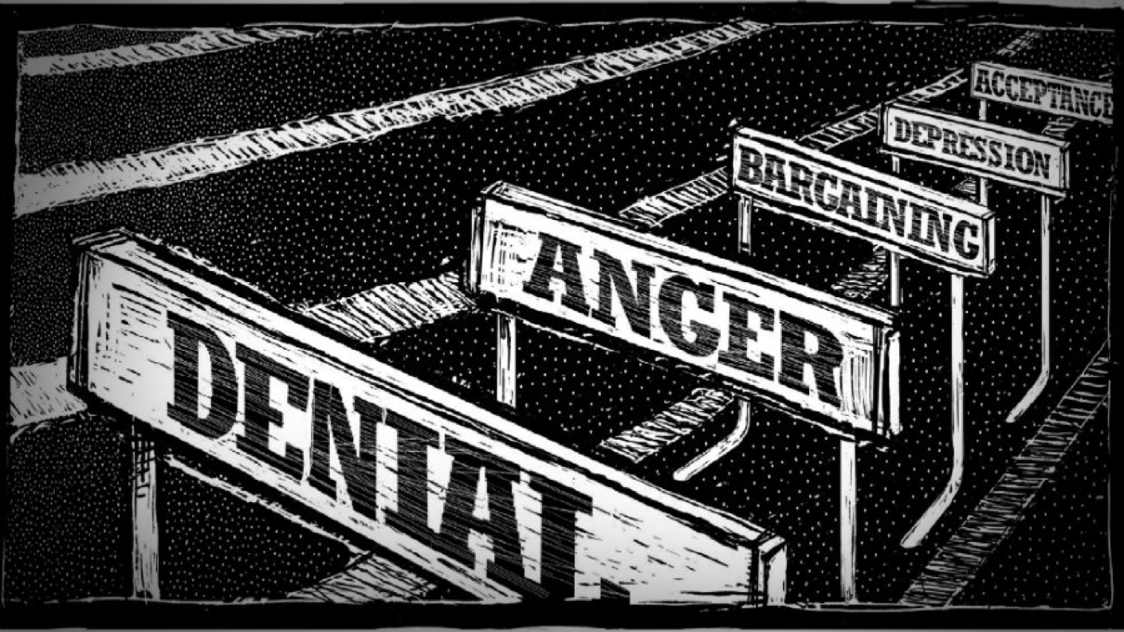
Family Acceptance
Parents may experience a variety of emotions such as loss, anger, confusion, embarrassment. Often parents go through a process that is similar to grieving with stages of denial, anger, bargaining, and depression.
They may feel powerless, judged, or socially isolated
Families undergo their own transition which requires nonjudgmental support and advocacy

Slide 46
Acceptance
Acceptance (and rejection) is not all-or-none… it is complicated and often described as a process with many hurdles along the way.
It is a process everyone in a TGD child’s life must go through at their own pace
/14

Slide 47
Family Acceptance
What’s the right thing to do for my child?
Focus on family acceptance as the most important factor in the child’s adjustment to their development and future outlook on life
Any rejection may lead youth to have shame that becomes internalized leading to "going underground" with secretive thoughts, feelings, and behavior that over time contributes to negative mental health outcomes
Research shows that even a little less rejection (or even access to just one supportive adult) has improved self-esteem and life-satisfaction, and decreased risk for depression, suicide, substance abuse, and HIV
/14

Slide 48
Family Acceptance
Advice to Parents:
Just Love Your Child
Focus on the Here and Now
Notes:
A lot of parents come to me asking, when I cannot understand, then what can I do? What can I say? What if I make a mistake? What if I am feeling uneasy about this? The worries can be overwhelming. At the end of the day, however, we all have 1 common mission – to make sure the child feels worthy of love, respect and acceptance.

Slide 49
Decision-Making

Slide 50
Informed Consent Model
Requires healthcare provider to effectively communicate benefits, risks and alternatives of treatment to patient
Requires healthcare provider to judge that the patient is able to understand and consent to the treatment
Informed consent model does not require or preclude mental health care
Recognizes that prescribing decision ultimately rests with clinical judgment of provider working together with the patient (“shared decision-making”; NOT “treatment on demand”)
Informed consent approaches are consistent with SOC 7, and more fully embraced in SOC 8
/14

Slide 51
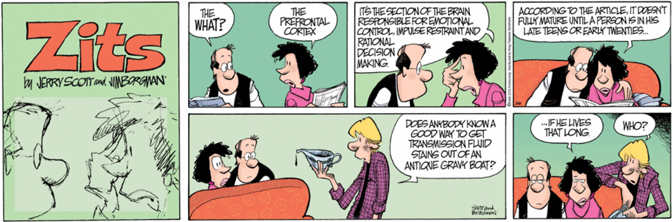
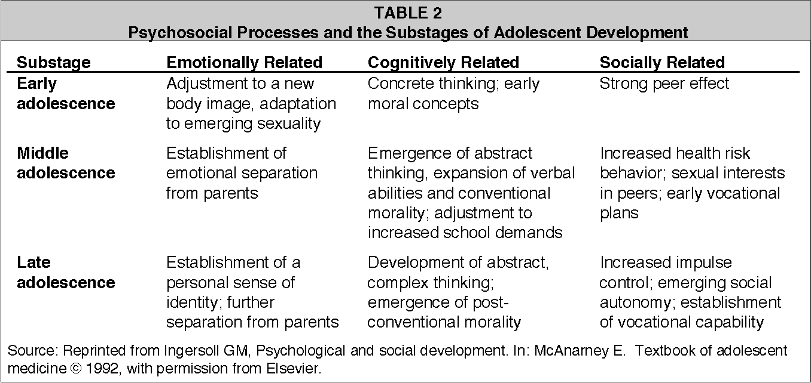
What about Adolescents?
Should/Can adolescents make important medical decisions about treatments that have irreversible effects?
/14

Slide 52
What about Adolescents?
Since most adolescents are not emancipated, the informed consent model inherently does not work because the adolescent is not able to make their own treatment decisions.
Additional considerations (complications?) when working with minors:
  Developmental maturity and capacity
  Family/Guardian involvement
  Irreversible endogenously driven development
/14

Slide 53
Gender Affirmative Care in Adolescents
Current research suggests that, rather than predict or prevent who a child may become, it is better to value them for who they are now, even at a young age. This fosters secure attachment and resilience.
Gender affirmative care is based on the belief that all children benefit from love and support.
The goal of gender affirmative care is NOT treatment, it is to listen to the child and, with the help of parents and families, build understanding that allows the youth to feel valued and cared for.
/14

Slide 54
Gender Affirmative Care in Children & Adolescents
Through strong, nonjudgmental partnerships with patients and their families, providers create an environment of safety in which complicated emotions, questions, and concerns related to gender can be appreciated and explored fostering understanding and acceptance.
Gender affirmative care is most effective in a collaborative system with access to medical care, mental health, and social services, including specific resources for parents and families.
/14

Slide 55
What is Gender Affirmative Care?

Slide 56
Gender Affirmative Care
Defined
An approach to caring for TGD youth that is focusing on understanding and appreciating the youth’s experience of gender in the context of their development. Engaging the youth and their family in nonjudgmental exploration and reflection fosters resiliency and self-discovery related to the youth’s authentic sense of self
This approach must be both family centered and developmentally informed
/14

Slide 57
Original Premises of the GAC Model
Transgender identities and diverse gender expressions do not constitute a mental disorder.
Variations in gender identity and expression are normal aspects of human diversity, and binary definitions of gender do not always reflect emerging gender identities.
Gender identity evolves as an interplay of biology, development, socialization, and culture.
If a mental health issue exists, it most often stems from stigma and negative experiences, rather than being intrinsic to the child’s gender identity.
(Hidalgo et al 2013)
/14

Slide 58
Elements of GAC
Terminology Note: “Transition,” although commonly used, implies the TGD person is changing. “Affirmation” implies the person is allowed to be their true self and society changes in order to accept and value them.
There are multiple ways that a person can be “affirmed”
  No sequence, prerequisites, assumptions, or requirements of interventions that make someone gender diverse
  Each intervention needs to be evaluated independently for appropriateness in the context of each individual patient
/14

Slide 59
Elements of GAC: Psychosocial Support
 | Definition | Age | Reversibility
Emotional Affirmation | Creating a safe space for patients and families to explore gender, share concerns and emotions openly, and learn to advocate. It includes early identification of dysphoria and other mental health concerns | Any | Reversible
Social Affirmation | Adopting gender-affirming hairstyles, clothing, name, gender pronouns, restrooms and other facilities | Any | Reversible
Legal Affirmation | Changing gender and name recorded on birth certificate, school records and other documents | Any | Reversible
/14

Slide 60
Elements of GAC: Medical Affirmation
 | Definition | Age | Reversibility
Puberty blockers | Gonadotropin-releasing hormone analogs such as leuprolide and histrelin | Early Adolescence. Limited benefit after Tanner 5, & WPATH recommends not using after age 16. | Reversible
Gender affirming hormone therapy | • Testosterone (assigned female at birth & masculinizing) • Estrogen plus androgen inhibitor (assigned male at birth and feminizing) | Early Adolescence on | Partially Reversible
/14

Slide 61
Elements of GAC: Medical Affirmation
Feminization
 | Onset | Max Change
Decreased Libido & Erections | 1-3 months | 3-6 months
Decreased Testicular Volume | 25% by 1 year | 50% by 2-3 years
Decreased Sperm Production | Not Enough Data | Not Enough Data
Breast Growth | 3-6 months | 2-3 years
Fat Redistribution | 3-6 months | 2-3 years
Decreased Muscle Mass | 1 year | 1-2 years
Softened Skin | 3-6 months
Decreased Terminal Hair | 6-12 months | >3 years
/14

Slide 62
Elements of GAC: Medical Affirmation
Masculinization
 | Onset | Max Change
Fat Redistribution | 1-6 months | 2-5 years
Acne | 1-6 months | 1-2 years
Voice Deepens | 1-3 months | 1-2 years
Amenorrhea | 2-6 months
Vaginal Atrophy | 2-6 months
Emotional Changes/Increased Libido | 2-6 months
Clitoromegaly | 3-6 months | 1-2 years
Increased Muscle Mass | 6-12 months | 2-5 years
Male Pattern Hair (Body/Face) | 6-12 months | 5-4 years
/14

Slide 63
Elements of GAC: Surgical Affirmation
 | Definition | Age | Reversibility
Gender-affirming surgeries | • “Top” surgery (to create a male-typical chest shape or enhance breasts) • “Bottom” surgery (surgery on genitals or reproductive organs) | Typically, Adults (Adolescent based on clinical situation) | Not Reversible
/14

Slide 64
Expectations
Create realistic expectations for the who, what, when and where of gender affirming care
  When can I have hormones or blockers?
  When can I have surgery?
  Can I get my name changed?
  When will I grow breasts/my voice drop/ my period stop?

Slide 65
Is there any evidence to support gender affirmative care in adolescents?
Gender Affirmative Care Model.
Hidalgo M. et al. (2013). The Gender Affirmative Model: What We Know and What We Aim to Learn. Human Development (This was the original description of the Gender Affirmative Care Model). 56(5), 285-290.
Wanger J et al. (2019). Psychosocial Overview of Gender Affirmative Care. J Pediatr Adolesc Gynecol. 32(6), 567-573.
Social Affirmation:
Olson KR, et al. (2016). Mental Health of Transgender Children Who are Supported in their Identities. Pediatrics. 137(3), e20153223.
Russell ST, et al. (2018). Chosen name use is linked to reduced depressive symptoms, suicidal ideation, and suicidal behavior. Journal of Adolescent Medicine. 63(4), 503-505.

Slide 66
Is there any evidence to support gender affirmative care in adolescents?
Puberty Blockers
Turban JL et al (2020). Pubertal Suppression for Transgender Youth and Risk of Suicidal Ideation. Pediatrics. 145(2).
Van der Miesen, et al (2020). Psychological Functioning in Transgender Adolescents Before and After Gender-Affirmative Care Compared With Cisgender General Population Peers. Journal of Adolescent Health. 66(6), 699-704.
de Vries, AL, et al (2014). Young adult psychological outcome after puberty suppression and gender reassignment. Pediatrics, 134(4), 696-704. doi:10.1542/peds.2013-2958

Slide 67
Is there any evidence to support gender affirmative care in adolescents?
Gender Affirmative Hormones:
Kuper, L. E., Stewart, S., Preston, S., Lau, M., & Lopez, X. (2020). Body Dissatisfaction and Mental Health Outcomes of Youth on Gender-Affirming Hormone Therapy. Pediatrics. 145(4).
Allen, L., Watson, L., Egan, A., & Moser, C. (2019). Well-being and suicidality among transgender youth after gender-affirming hormones. Clin Pract Pediatr Psychol, 7(3), 302-311.
Timing of Gender Affirming Interventions:
Sorbara JC, et al. (2020). Mental health and timing of gender-affirmative Care. Pediatrics. 146(4).

Slide 68
Dispelling the Myths and Misinformation: What is Gender Affirmative Care
Jason Rafferty, MD, MPH, EdM
Gender & Sexuality Program Medical Director
Hasbro Children’s Hospital
Clinical Assistant Professor
Warren Alpert Medical School of Brown University

Slide 69

Mental Health Presentation
December 8, 2023
Dr. Amy Nunn
Executive Director Rhode Island Public Health Institute
Professor of Public Health and Medicine, Brown University

Slide 70



Rhode Island Public Health Institute (RIPHI)
RIPHI is a 501(c)(3) non-profit organization based in Providence, RI.
Our mission is to reduce health disparities in RI and beyond.

Slide 71

Healthcare Access in Rhode Island
5% of adult Rhode Islanders are uninsured (2021) (BRFSS) compared to 16% of ODH patients
14% of LGBTQ+ individuals in RI noted inability to access medical care because of cost in the last year (2021) (BRFSS)
  Hispanic (16%) and Black (9%) populations in the state experience similar difficulties with healthcare access
ODH works to reduce these barriers
Data from 2021 Rhode Island BRFSS

Slide 72

Open Door Health (ODH)
Ambulatory care center located in upper South Providence.
We seek to reduce health disparities for LGBTQ+ populations.
Provide primary care, gender care, and sexual health services.
ODH serves approximately 5,100 patients
Center for Public Health innovation

Slide 74


How We Innovate: Novel Service Delivery
Express STI visits
FileMaker data collection tool
Nurse led PrEP
Early adoption of novel treatments (e.g., Doxycycline as PEP)
Injectable PrEP

Slide 75

A Need for Mental Healthcare at ODH
In a recent survey, 43% of ODH respondents indicated they experienced poor mental health for more than 10 days of the previous month.
32% of respondents indicated mental health as something they currently need help with.

Slide 76
Mental Health and LGBTQ+ Populations
Overall, LGBTQ+ individuals at ODH are more likely to experience symptoms of depression and anxiety than their counterparts.
PHQ-2 Depression Score Data
 | All ODH Patients | Heterosexual | Sexual Minorities | Cisgender | Gender minorities
% Scoring >=3 | 9.1% | 8.4% | 9.4% | 8.0% | 18.4%
Average Score | 0.93 | 0.73 | 1.01 | 0.82 | 1.64
GAD-2 Anxiety Score Data
 | All ODH Patients | Heterosexual | Sexual Minorities | Cisgender | Gender minorities
% Scoring >=3 | 12.9% | 5.4% | 15.7% | 9.4% | 25.4%
Average Score | 1.18 | 0.67 | 1.38 | 1.04 | 2.19
Notes:
Note: The % of individuals scoring higher than or equal to three was the chosen metric because that is the cutoff point in both measures for clinical intervention for Depression and Anxiety.
Here are two sources that I think explain it well:
PHQ-2 (Depression): https://www.hiv.uw.edu/page/mental-health-screening/phq-2#:~:text=A%20PHQ%2D2%20score%20ranges,major%20depressive%20disorder%20is%20likely.
GAD-2 (Anxiety): https://www.hiv.uw.edu/page/mental-health-screening/gad-2

Slide 77
Depression and Anxiety Symptoms at ODH

Slide 78

External Factors Effecting Mental Health
Current mental health research at ODH asks questions about external pressures and their effects on LGTBQ+ patient’s mental health:
  So far, 77% of responses indicate that the current political climate has contributed to anxiety or depression.
  45% of individuals have sought therapy to cope with these factors.

Slide 79


Get to Know Our Team
https://www.youtube.com/watch?v=2LN6-nSJhRU

Slide 80
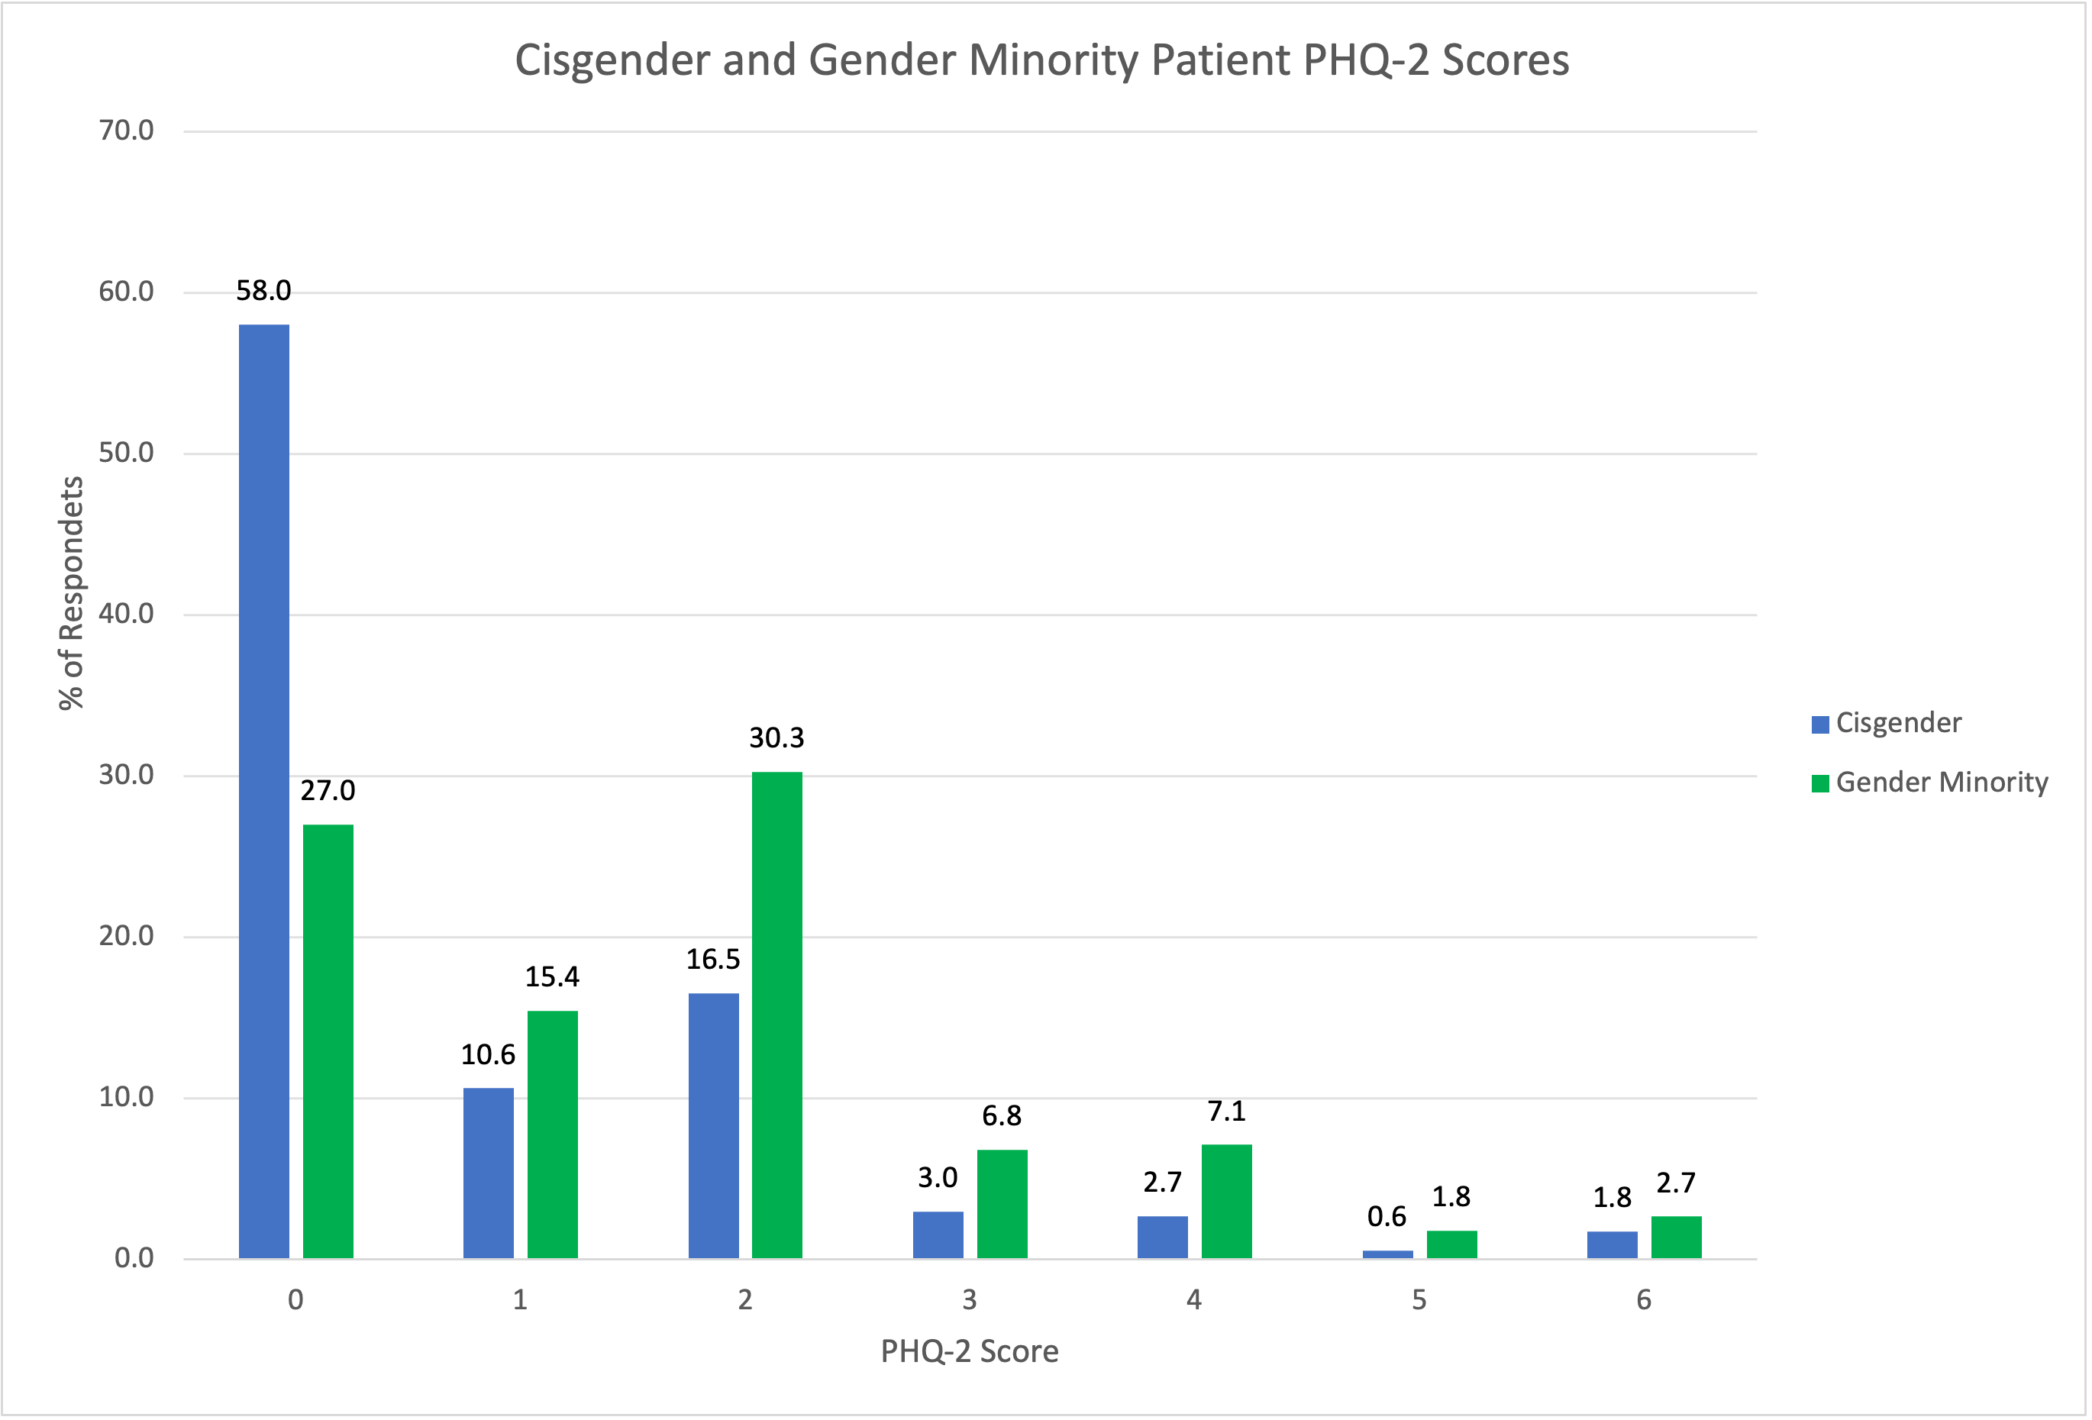
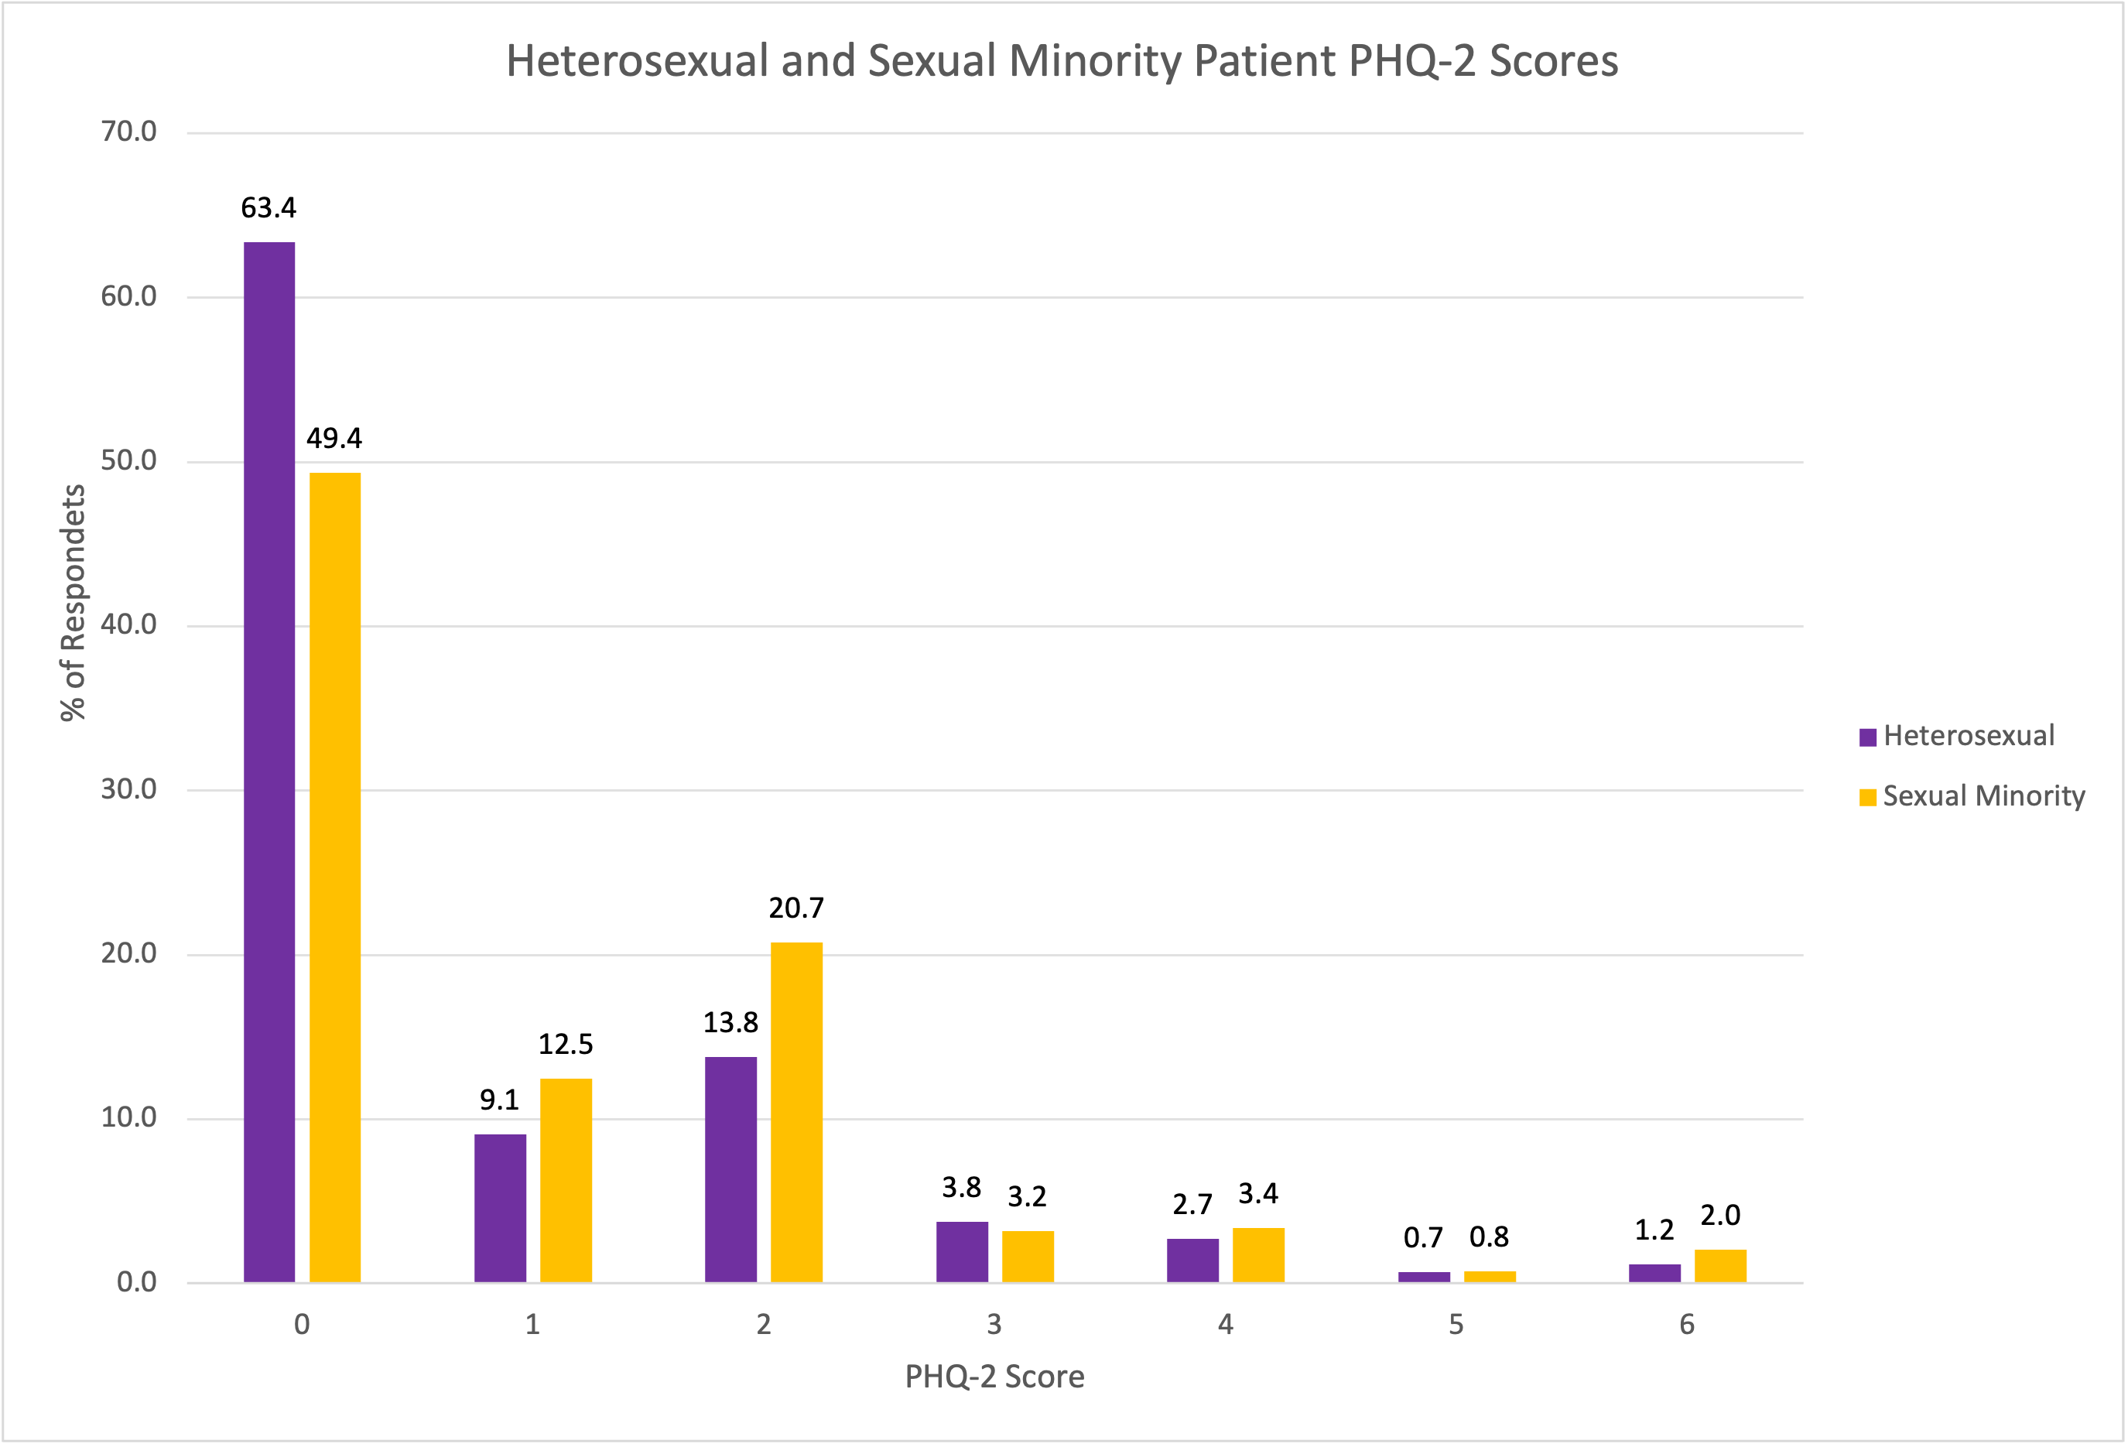
Comparing PHQ-2 Depression Scores

Slide 81
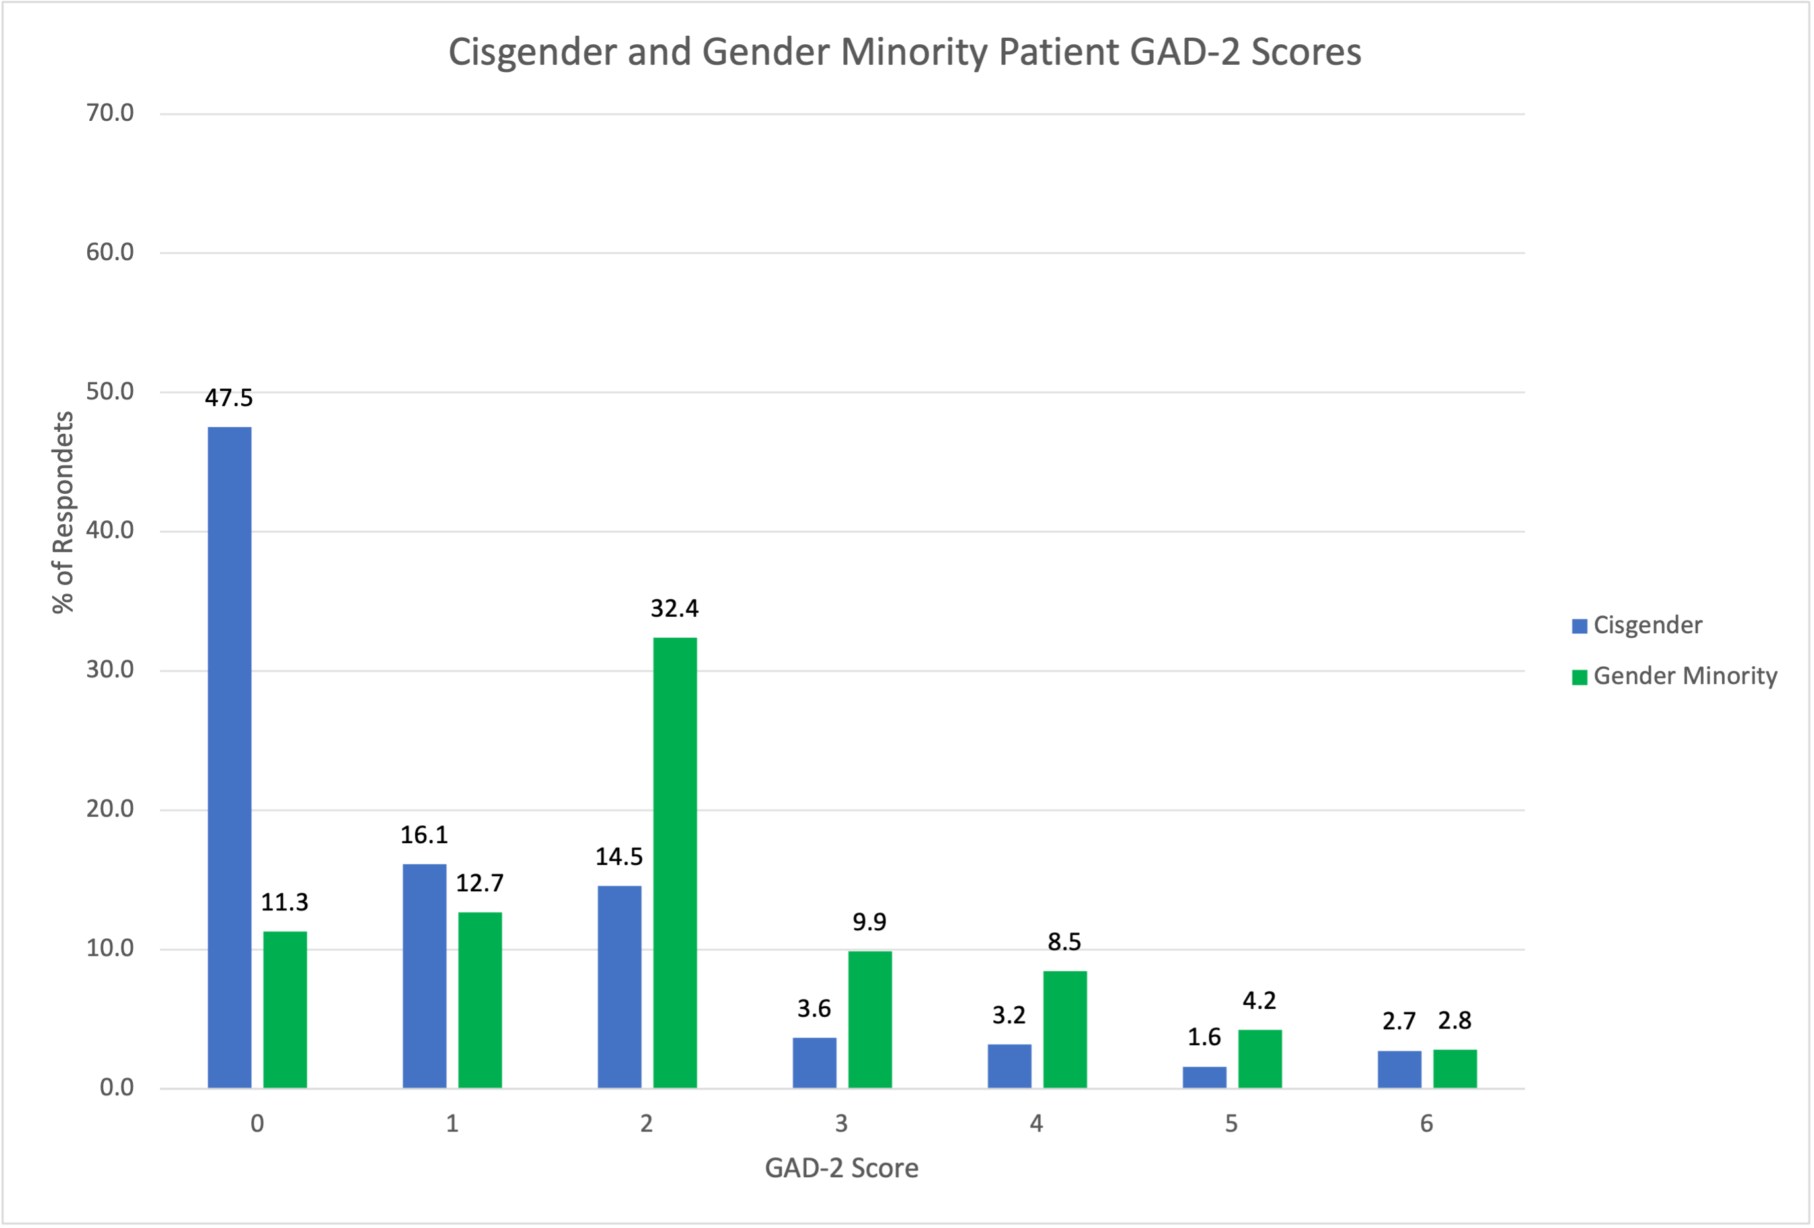
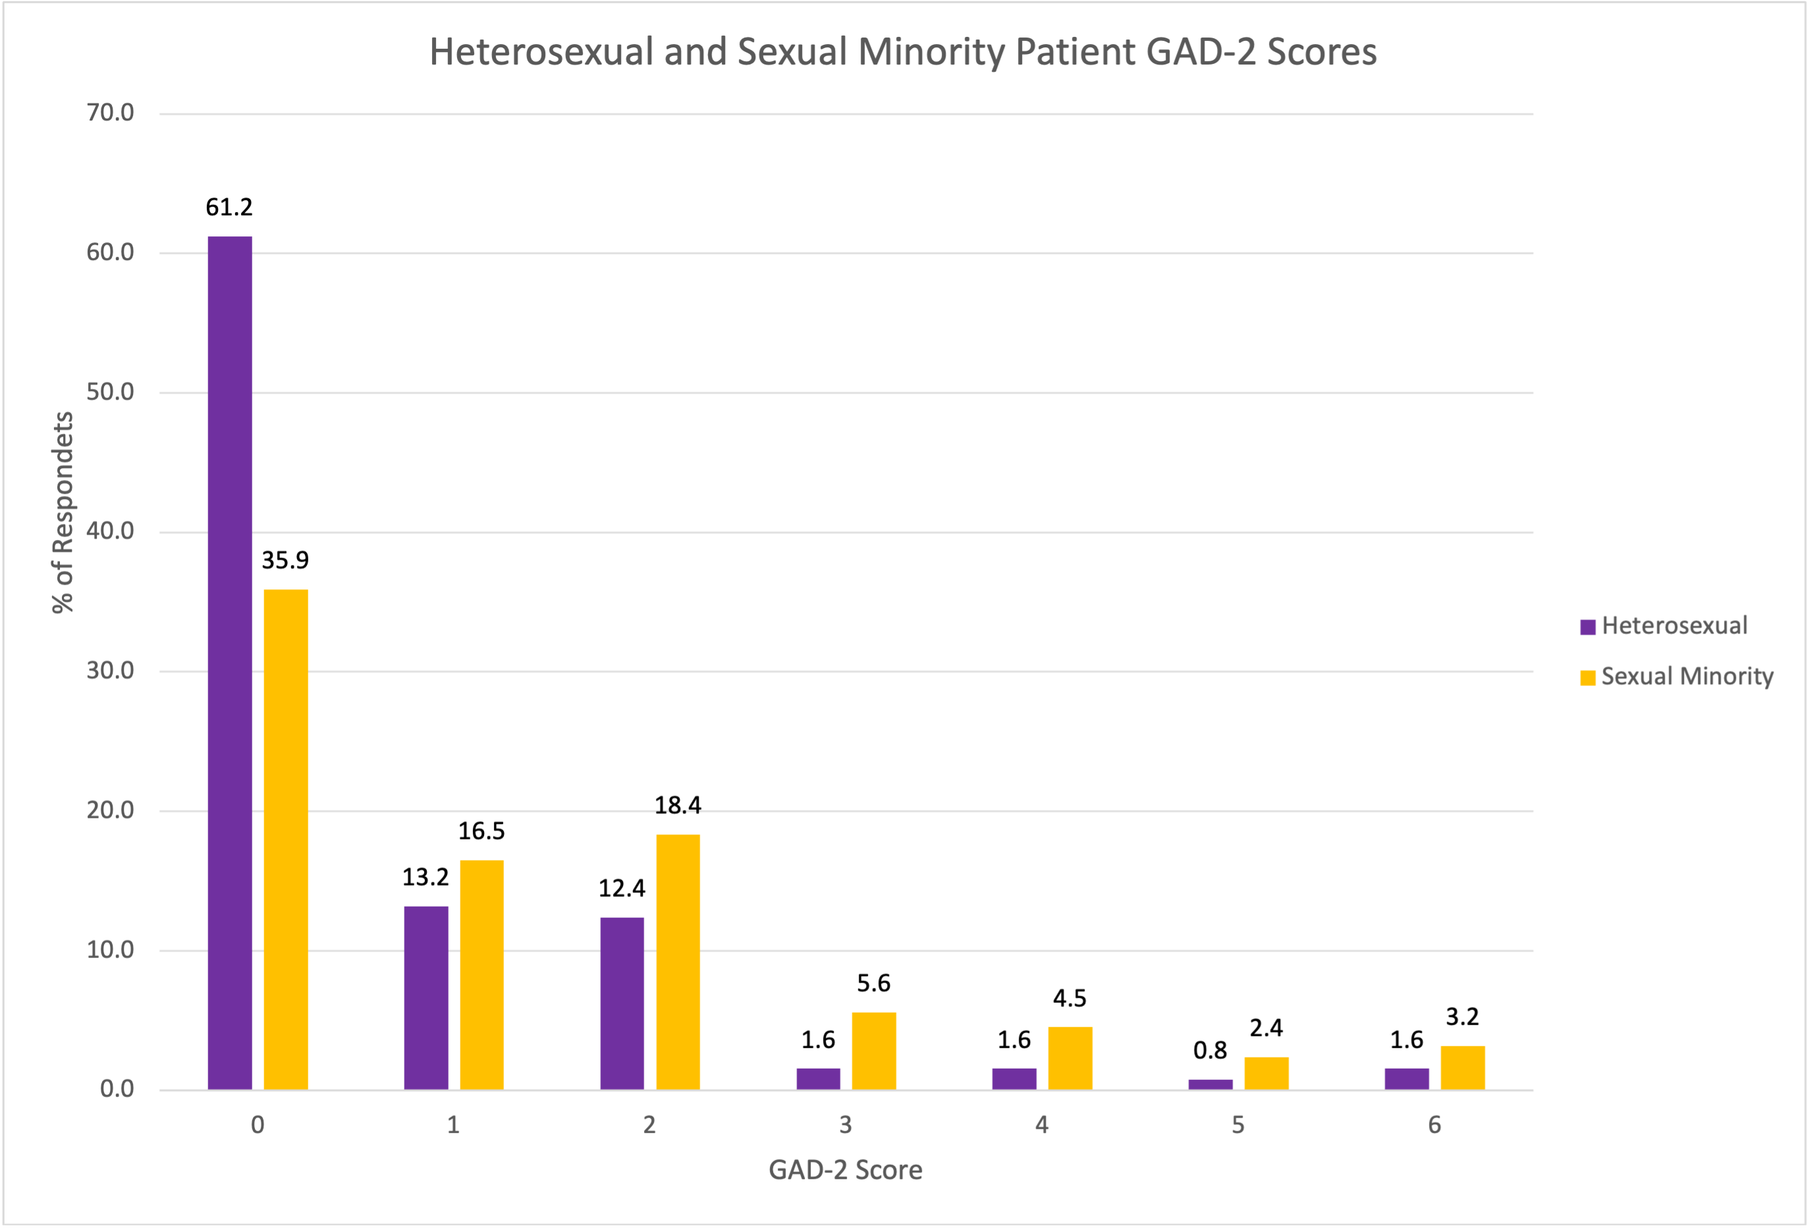
Comparing GAD-2 Anxiety Scores

Slide 82
CME Credits & Eval
Reminder to please complete the evaluation in order to claim CME credits!
Claim CME credits here: https://www.surveymonkey.com/r/ZDZS5HG
The AAFP has reviewed ‘Advancing Comprehensive Primary Care Through Improving Care Delivery Design and Community Health,’ and deemed it acceptable for AAFP credit. Term of approval is from 03/18/2022 to 03/18/2023. Physicians should claim only the credit commensurate with the extent of their participation in the activity. NPs and RNs can also receive credit through AAFP’s partnership with the American Nurses Credentialing Center (ANCC) and the American Academy of Nurse Practitioners Certification Board (AANPCB).

Slide 83




THANK YOU
www.ctc-ri.org
ctc-ri

